Slide 1
Cascading Style Sheets (CSS)

Slide 2

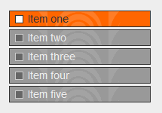
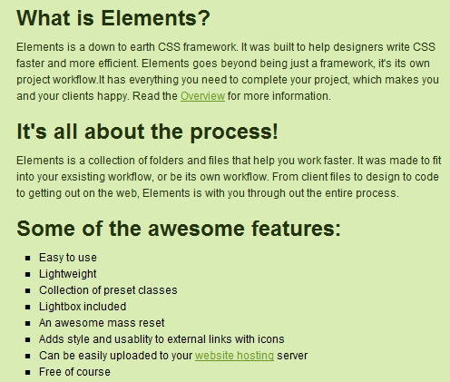
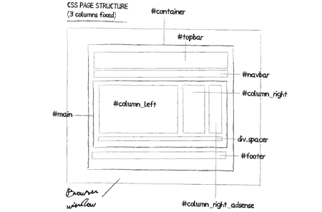
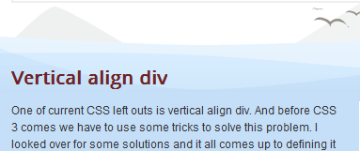
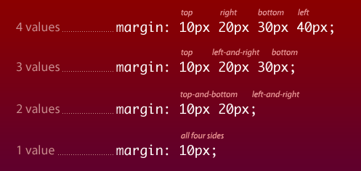
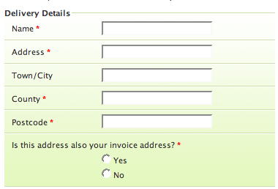
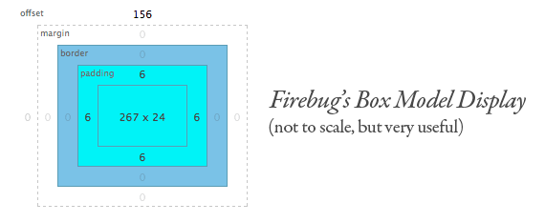
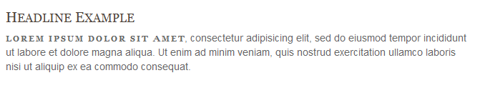
What Web Designers Need to Know About CSS
Page Layouts
Styling and Making Lists
Box model and Positioning
Typography
Styling Forms
Using CSS Frameworks
Best Practices
CSS Hacks

Slide 3
Early HTML version 3.2 example
<font face=“Arial, sans-serif” size=2 color=blue> Chapter One </font>
<p><font face=“Times Roman, serif” size=1 color=black> The mean mode or ... </font></p>
<i> This text is emphasized. </i>
<i><font color=red> This is emphasized in red.</font></i>
<i> <font color=blue> Some blue . </font></i>
presentation
content

Slide 4
HTML version 3.2 issues
A problem with early HTML web pages (prior to CSS) is that the content and its presentation are closely integrated
The meaning of content and how that content is presented should be separated. Why?
The “user agent” receiving the HTML may be a desktop browser, a printer, a PDA, a cell-phone, or a tablet – the HTML intended for display to the browser may not be acceptable on the printer or other devices
Also, you may want to see the web page using your own preferred presentation style as defined in the browser
The process of updating the appearance of the content should be simple and efficient

Slide 5
Style Sheets
With HTML v4 (published 1998) a new approach to web page definition was developed using style sheets
A style sheet is a set of defined presentation instructions that is separate from the content
The concept of style sheets had been around since SGML days (1980s)
style
CSS
HTML
HTML
content

Slide 6
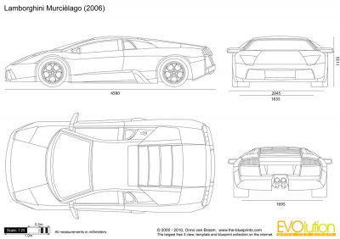

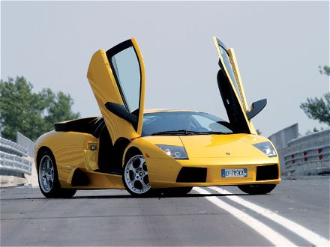
Style and Content Together
+
=

Slide 7


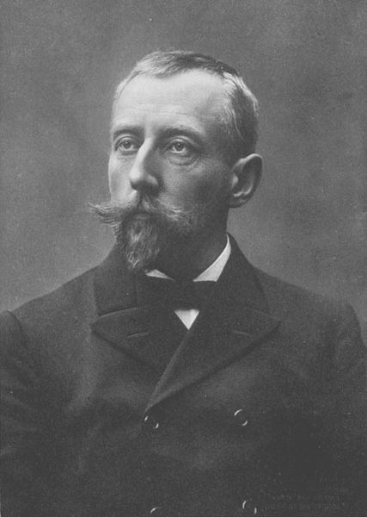
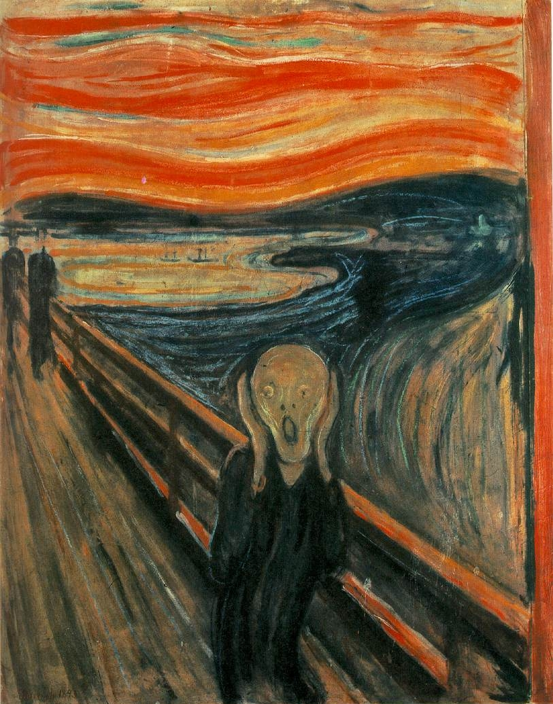
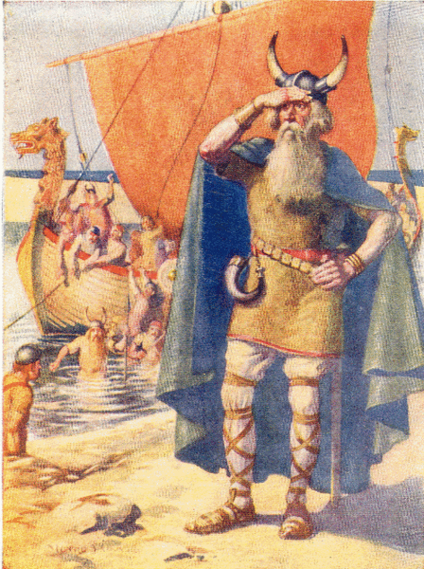



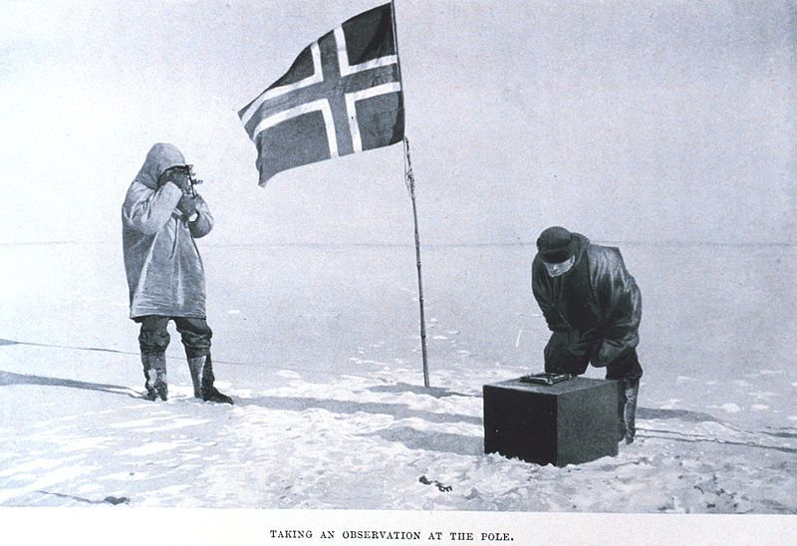


The creator of CSS came from the land that gave the world ...
Håkon Lie – developer
of CSS (1994)

Slide 8
Origin of CSS
W3C has produced three style recommendations CSS1, CSS2, and CSS3 – each level builds on the previous version - http://www.w3.org/TR/CSS21/
Not all browsers implement these changes consistently
  http://tools.css3.info/selectors-test/test.html
Early browsers (MS Internet Explorer 3 and 4) did not fully support CSS
As of July 2010, no browser has yet fully implemented CSS3 – some more than others
http://en.wikipedia.org/wiki/Comparison_of_layout_engines_(CSS)

Slide 9
Evolution of CSS Features from W3C
downloadable fonts
relative positioning
functions
z-index
voice
absolute positioning
text shadow
colour by
HSL notation
margin
padding
media types
font properties
multi-
column
layout
cursors
images
border
aural style
sheets
background
text colour
list
2d and
3d
transform
table
text spacing
CSS 1 (1996)
CSS 2 (1998)
CSS 3 (201?)

Slide 10
Why CSS?
CSS skills are essential for web page design
HTML skill allows you to understand how to structure the HTML content but not how to present it effectively
Easily change the presentation of an entire web site by modifying a single CSS style sheet
CSS skills vital in web projects
Use a CSS validator to check your CSS is correct
If there is a problem with your CSS, usually there are no error messages – check with Firebug on Firefox or Internet Tools on IE (ver 8)

Slide 11
What is CSS ?
Like HTML CSS is simple human-readable text
CSS is not a programming language like Java or PHP
CSS is not the same as HTML – CSS cannot be present without HTML or XSL
CSS will help simplify your web content presentation and make it more manageable
CSS will also work with XSL, another web technology

Slide 12
CSS Style Attribute and Tag
CSS has a style attribute and style tag (selector)
<h1 style = “property : value;
property : value; ... ”>
<style>
selector { property : value;
property : value; ... }
</style>
the selector is usually an HTML tag name
The final ; is optional.
declaration

Slide 13
CSS Style Layout
CSS definitions are written free format
<style type=“text/css”>
h1 { color: blue; }
h2 { color: green;
}
h3 { color: red;
text-weight: normal;
}
</style>
The closing brace
can go anywhere
and each declaration
can be on a
separate line.
Optimizing the CSS for human readability
is desired.
The order of the CSS properties listed
in the style does not matter to the user agent.
If properties are duplicated in the same style,
the last one defined is used.

Slide 14


CSS Properties
Properties are relevant to the selector
Properties and values are case insensitive but standard is to use lowercase
Some of the CSS property names are not consistent unfortunately: e.g. color:blue
not text-color:blue or text:blue
Examples of CSS property names: background, border, margin, padding, font-size, font-family, word-spacing, visibility
Not every property works consistently for each browser! Test for each browser and version.

Slide 15
CSS Values
Values can be numbers, strings, keywords, lengths, colour values, urls or percentages
For numbers, only decimal values
Strings, use double or single quotes
For keywords (e.g. auto, none or any of the known colour names), do not use quotes (e.g. color:“red” is illegal; color:red is legal)
A zero length value does not require a length identifier (e.g. CSS style margin:0 )
Colour values can be a keyword or RGB notation (or HLS notation for CSS 3 browsers)

Slide 16
CSS Strings
A string can be written with double quotes or single quotes (no mixing though)
A double quotes can appear inside a double quoted string but the double quotes is escaped by preceding it with a backslash. Similarly for single quotes
“here is my ‘string’ ”
“this is another \“string\””
‘another “string” ’
‘yet another \‘string\’ ’

Slide 17
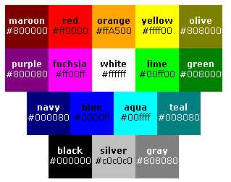
Colour keywords
colour keywords: aqua, black, blue, fuchsia, gray, green, lime, maroon, navy, olive, orange, purple, red, silver, teal, white, and yellow.
RR GG BB
is the format for mixing red/green/blue.
If the two hexadecimal digits
of the colour are the same,
then you can specify the one digit.
e.g. white is #fff or #ffffff
alternative RGB formats:
rgb(255, 255,255) or
rgb(100%, 100%, 100%) = white
http://www.w3.org/TR/SVG/types.html#ColorKeywords

Slide 18
HLS Notation
CSS 3 introduced the HLS colour notation
H = hue L = lightness S = saturation
RGB colour notation is hardware-oriented (based on CRT monitors)
RGB is not intuitive beyond the basic colours
Hue is the angle of the colour circle
0% lightness is black; 100% lightness is white
100% is full saturation; 0% saturation is grey

Slide 19
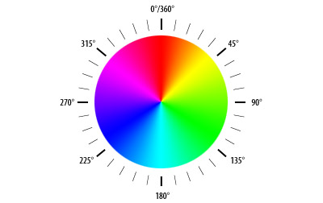


HLS Notation
Examples,
b { color: hsl(0, 100%, 50%) } /* red */
p { color: hsl(120, 100%, 50%) } /* green */
div { color: hsl(240, 100%, 50%) } /* blue */

Slide 20
Transparency – Alpha channel
Another CSS 3 technique used by FF3+, Opera, Chrome, Safari) is using the alpha channel in RGB or HSL
background-color: rgba(100, 155, 164, 0.4); /* alpha=0.4*/
background-color: hsla(200, 40%, 20%, 0.4);
Using this method the settings do not affect child elements as opacity property does.

Slide 21
Vendor-specific extensions
Identifiers may start with a hyphen (-) or underscore (_) ... they are reserved for vendor-specific extensions
E.g. –moz-box-sizing for Mozilla browsers
-ms-, mso- for Microsoft browsers
-moz for Mozilla
-o- for Opera
-rim- for Research in Motion
-webkit- for Apple

Slide 22
CSS Values - Examples
<style type=“text/css”>
p { background-color: gray;
background-position: 40% 50%;
background-size: 10em 10em;
background-image: url(blue.png);
background-repeat: round round;
border-style: solid;
border-color: #FF30A0;
width: 50px;
font-family: ‘Courier New Times’ ;
}
</style>
CSS colour keyword
CSS percentages
CSS lengths
CSS URL
CSS keywords
Colour in RGB format
CSS length
CSS string

Slide 23
CSS errors
If the CSS property is unknown, the user agent ignores it
h1 { color: blue; angle: 30deg; }
is treated as h1 { color: blue; }
If the CSS declaration uses an illegal value, the user agent ignores it
img { float: left here } is ignored
If the CSS declaration is malformed, the user agent tries to work around it
p { color: blue; color } uses p { color: blue }

Slide 24
Lengths
Fonts scaled using the font-size property
Two types of length units: relative and absolute
  Relative lengths units specify a length relative to another length property – also called ‘elastic’ or ‘fluid’
    More easily scaled from one display device to another
    em – the ‘font-size’ of the relevant font
    ex – the ‘x-height’ of the relevant font (rarely used)
    px – pixels, relative to the viewing device

Slide 25
Lengths
  Absolute lengths units are useful only when the physical properties of the output device (e.g. printer) are known – do not use for video display
    in – inches
    cm – centimeters
    mm – millimeters
    pt – points – 72 points equal one inch – only for print
    pc – picas – 1 pica equals 12 points—only for print
1em = 12pt = 16px = 100%
(generally by default unless you change the working font )

Slide 26
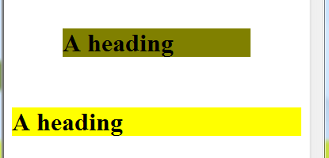
Lengths CSS
<h1 style="margin:2em;"> defines a margin space around the h1 heading. The space is twice the length of the font’s lower-case m as a heading.
2em
2em
2 em is the width measure of two letter M’s of the selected
font.

Slide 27
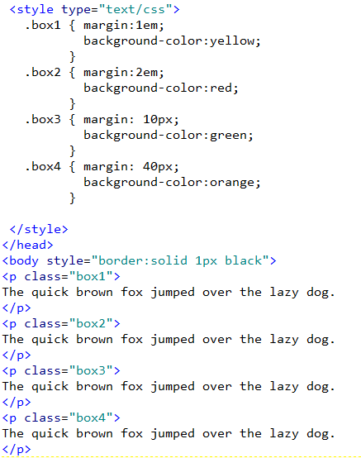
CSS Lengths - Example
Define four boxes in
CSS – each with a
different margin:
1em, 2em, 10px,
and 40 px

Slide 28
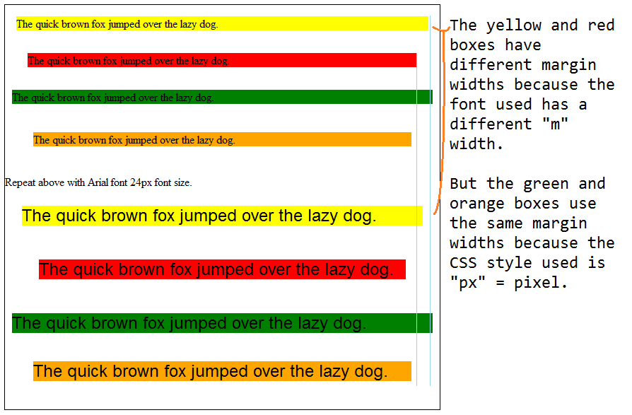
CSS Lengths - Example

Slide 29
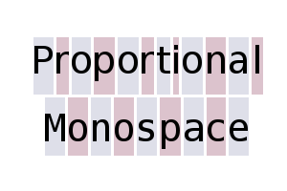



Fonts in CSS
A font is a typeface used to display text
A font is an operating system resource, not a browser resource
CSS recognizes five generic font families: serif, sans-serif, monospace, cursive, and fantasy
Monospace is a fixed size font; serif and sans-serif are typically proportionally spaced fonts
Serif fonts have flared or tapered ends to the letters; sans-serif fonts do not.

Slide 30
Fonts in CSS
Serif family of fonts include: Times New Roman, Century Schoolbook and Garamond
  Most widely used of the font families for print books, magazines
  But sans-serif considered easier to read on computer screens http://www.w3.org/TR/CSS2/fonts.html#q1

Slide 31
Fonts in CSS
Sans-serif font family includes: Arial and Verdana
  Much easier to read on monitors as the “serifs” can blur on lower resolution screens
  Verdana was invented for use on the web
Monospace: Courier New, Lucida,Consolas
  Also called “fixed pitched” fonts because all characters have the same width
  Use for showing programming code or implying typewritten text
  Before CSS this was required for text alignment in table format especially for columns of dollar amounts (decimal point alignment)
http://en.wikipedia.org/wiki/Samples_of_Monospaced_typefaces

Slide 32
Fonts in CSS
Limit usage of fantasy and cursive fonts as they are not widely available and can be hard to read – especially for non-English speakers
  If you must use them, keep text very short
Cursive e.g. Comic Sans, Vivaldi
Fantasy e.g. Copperplate, Impact

Slide 33
Fonts in CSS
When specifying the font family, list your preference first, and the most generic last
If the font name has multiple words, put it in double quotes, or in single quotes if using the style attribute
  p { font-family: “Courier New”, Courier, monospace }
h1 { font-family: Verdana, Geneva, Arial, sans-serif }
h2 { font-family: "Courier New", Courier, monospace }
h3 { font-family: "Times New Roman", Times, serif }

Slide 34
Fonts in CSS
font-weight sets the level of ‘thickness’ of the characters in text
  Default is normal (or use number 400)
  bold, bolder, lighter same as values 700, 800 and 300
font-style indicates the style
  Default is normal
  italic, oblique
font-size sets the size of the font
  Can use a length value (e.g. 12px or 1.2em or 120%)

Slide 35
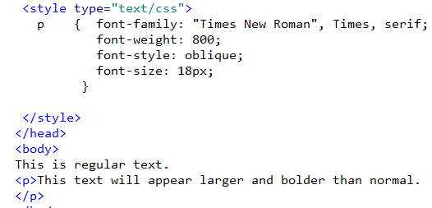
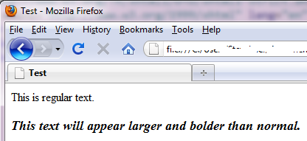
CSS Fonts Example

Slide 36
CSS Text Properties
line-height refers to amount of space between lines of text
text-decoration can be set to normal, underline, line-through, or none
text-transform can be none, capitalize, uppercase or lowercase
text-align can be left, right, center, justify
text-indent is amount of indented space

Slide 37
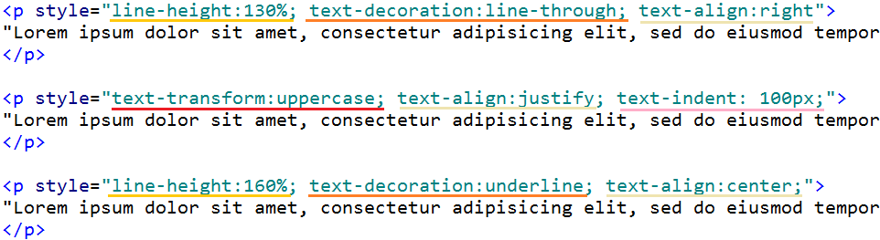
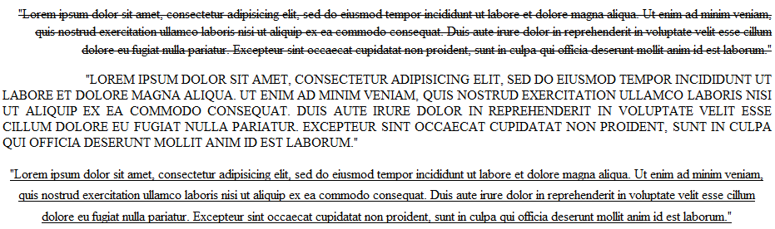
Three paragraph examples

Slide 38
Fonts and the Web
Can a custom font be used in a web page?
CSS level 2 introduced the @font-face property to allow the HTML to access different fonts
Extra time needed to download the font file
Font technologies: Embedded OpenType (EOT) – only Microsoft IE 4+, sIFR (Scalable Inman Flash Replacement), Font Linking
  See http://www.fontembedding.com/
  http://www.cs.camosun.bc.ca/~langs/comp140-10/lectures/cssnotes/cssFontDownloadTest.html

Slide 39
CSS Property Shortcut
For defining background, border, font, margin, or padding properties, there is a shortcut to collapse all the sub-properties into one.
Order of the values does not matter
style="font-weight: bold; font-family: Verdana, sans-serif; font-size: 2em;
line-height: 1.2em;"
  can be collapsed into this CSS shortcut:
  style="font:bold 2em/1.2em Verdana,sans-serif; "

Slide 40
CSS Property Shortcut
Another example:
style="padding-top:5px; padding-right:10px; padding-bottom:8px; padding-left:12px;“
style = "padding: 5px 10px 8px 12px;"
The order is : T R B L (clockwise from noon) - or TRouBLe
style = "padding: 5px 10px;" means 5px for top and bottom; 10px for left and right
style = "padding: 5px;" means 5px all around

Slide 41

Opacity
Visual elements on a web page can be made transparent with the CSS opacity property
Non- IE browsers:
opacity: 1.0; /* opaque */
opacity: 0.7;
opacity: 0.5;
opacity: 0.2;
opacity: 0.0; /* transparent */

Slide 42
Opacity
IE browsers ( IE v6-8) use the filter property if the element uses the hasLayout property (e.g. table, img, input, button, textarea)
filter: alpha(opacity=40);
For IE 8 use the –ms-filter property:
-ms-filter: “progid:DXImageTransform.Microsoft.Alpha (opacity=40)”;
To work in all IE versions, define the filter property after the –ms-filter property.

Slide 43
URL value
URLs to image files are values to CSS properties – use the url CSS function
URL may be single-quoted or double-quoted or not quoted
body { background: url("http://www.example.com/forest.jpg") }
li { list-style: url(http://www.example.com/redBullet.png) }

Slide 44
Background Properties
color sets the text colour
background-color can be transparent or a colour value
background-image can be none or a URL value
background-attachment can be scroll or fixed
background-repeat can be no-repeat, repeat, repeat-x, repeat-y
background-position can be a length, top, center, bottom, left, or right

Slide 45
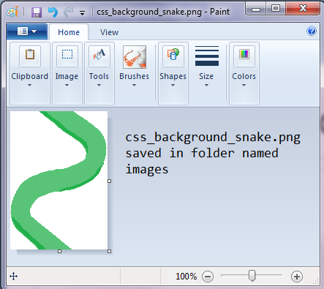
CSS Background - Image

Slide 46
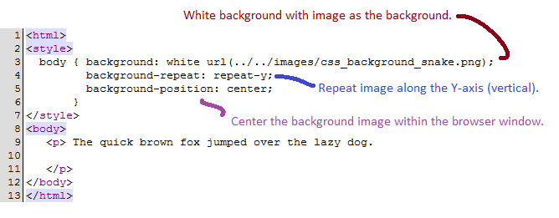
CSS Background - Style

Slide 47
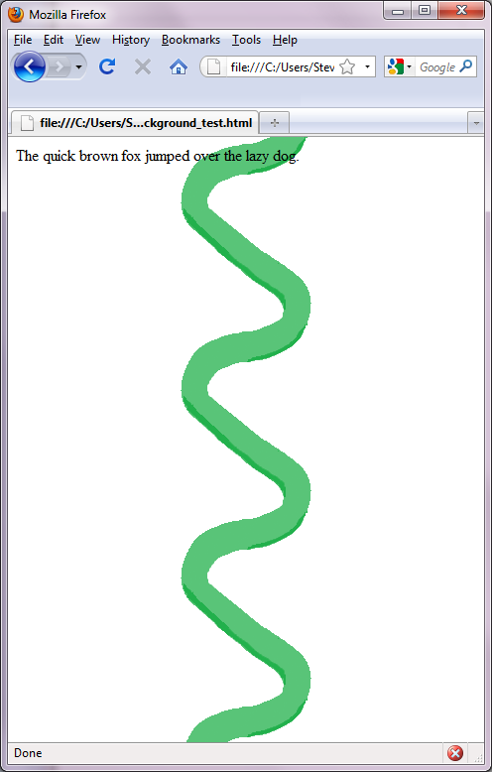
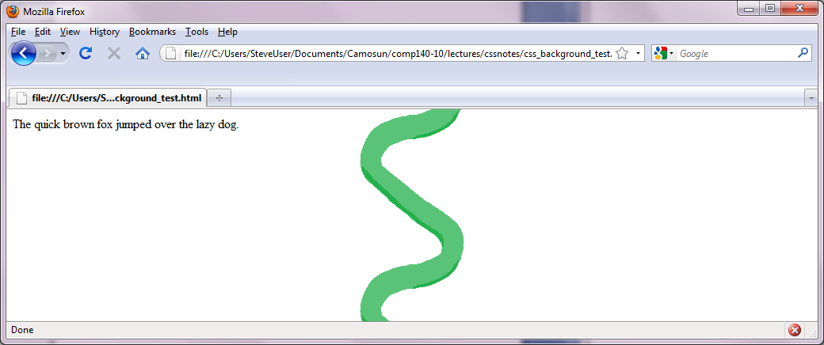
CSS Background - Resize Window
background-position: center
link

Slide 48
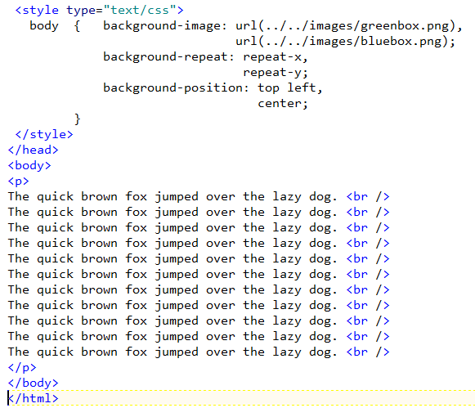
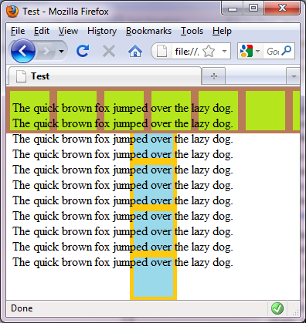
CSS Background – repeat x, y
Does not work on any IE version prior to v9

Slide 49
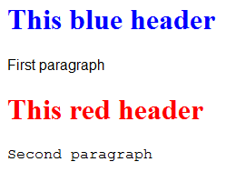
Style Attribute example
Example of CSS – the style attribute is used
<h1 style="color:blue"> This blue header </h1>
<p style="font-family:Arial;"> First paragraph </p>
<h1 style="color:red"> This red header </h1>
<p style="font-family:Courier;"> Second paragraph </p>

Slide 50
Style Element example
Use of the style element in an HTML document
<style type="text/css">
h1 { color: blue; }
h2 { color: red; }
p { font-family: Arial, Helvetica; }
</style>
Defines style for the tags for this HTML document only
When two or more separate style elements are defined in the same HTML document, they are all merged together as one element – but when properties conflict – those defined later will override the earlier ones

Slide 51
CSS Media types
CSS can support different output depending on the “user agent” (e.g. browser, print, tv, braille, handheld, aural)
Style sheet definition in the <link> tag
  <link rel=“stylesheet” type=“text/css” media=“print, handheld” href=“print.css”>
Or in the style sheet
  @import url(“loudvoice.css”) aural
  @media print { ... styles for print }

Slide 52
CSS Levels of Style
CSS has three levels of style
  Inline style
    Defines the style just for the one occurrence of that element
    Style attribute is used within the HTML element
  Embedded style (also called Internal style)
    Defines a set of tag styles for just the HTML document
    Style tag is used
  External style (also called Linked style)
    Defines a set of tag styles to be used for multiple HTML documents

Slide 53
Inline Style
The style attribute within the element defines the desired presentation appearance
CSS inline style is used when a specific instance of an element in the HTML requires a unique format
<h1 style="color:blue">Blue heading </h1>
<h1> No style heading</h1>
<h1 style="color:red">Red heading </h1>
Style applies only to this text
Style applies only to this text

Slide 54
Embedded Style
Styles for the HTML file’s tags are defined within the HTML file inside the <head> section
The styles are for that HTML document only
The CSS styles are enclosed in the tag
<style type="text/css">
h1 { color: blue; }
</style>
Note how the style is
defined.

Slide 55
External Style
The CSS styles are defined within a separate file e.g. file site.css contains:
h1 { color: blue; }
A <link> element is used in the HTML file to indicate the name of the external CSS file
The <link> element is defined in the HTML file’s head section
<link rel="stylesheet" type="text/css"
media="screen" href="site.css">

Slide 56
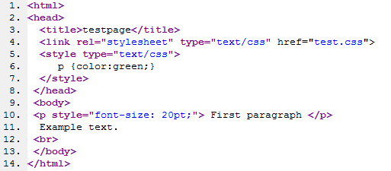
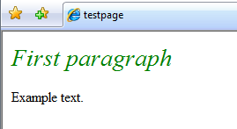
CSS
What this means is that you may define different styles for the same tag
This file contains the line:
p { font-style: italic; }
The properties are 20pt and
font style italic and green.

Slide 57
Cascading
“Cascading” = Cascading order
  HTML elements may have different styles applied to them – which one is used by the browser?
  All styles “cascade” into a single style sheet in part by the following proximity rule
    Browser default style -- lowest priority
    External style sheet (a .css file)
    Embedded style sheet (inside <head> section)
    Inline style (inside an HTML tag) – highest priority
  there are other, more CSS complicated rules

Slide 58
Author and User Style sheets
Users may define their own style sheets
Author’s style sheets will override any style defined in the user’s style sheet
User’s style sheet will override the default style sheet
Internet Explorer: Tools | Options | Accessibility
Firefox: create the text file userContent.css and save it in your Application Data folder under Firefox chrome folder

Slide 59
CSS Syntax
Always use a colon to separate property and value – browsers will not display error messages.
Selectors, values, properties are case-insensitive – but lowercase encouraged
Order of properties does not matter
Order of CSS definitions does not matter (but if you have duplicate selectors, only the last one is used)
If the value is multiple words, use double quotes
Multiple properties can be specified with a semicolon between them
Do not leave a space between the value number and the units – will not work in Firefox (e.g. “10px” not “10 px”

Slide 60
CSS Syntax
Separate lines for each property for readability
Comments are enclosed using /* */
p { color:black;
font-family: "Times New Roman";
text-align: left;
font-size: 15pt; /* test */
/* font-style: italic; */
}
This style property is
ignored by the browser.

Slide 61
CSS Selector
A selector is the first part of the CSS style rule and it indicates what HTML is formatted.
h1 { color:blue; }
p { color:#00ffcc; }
li { font-weight:bold; }
Selectors

Slide 62
CSS Selector Categories
Type Selector
Universal Selector
Descendant Selector
Child Selector
Attribute Selector
Class Selector
ID Selector
Pseudo-classes
Pseudo-elements

Slide 63
Type Selector; Universal Selector
Type selector matches the name of an HTML element – every instance of that element in that document
Universal selector is written as a single asterisk and matches any element in the document
h1 { font-family: Arial; }
All h1 elements will use this rule.
* { font-family: Arial; }
All elements will use this rule.

Slide 64
Descendant Selectors
When a style rule needs to be applied to an element contained anywhere within another element, CSS descendant selectors are used
p b { color: red; }
Any b elements defined within
an p element will use this rule.
The b element is the descendant of p element.
<p>This is <b>important</b>
</p>
<p> <div> This is
<b>important</b> </div>
</p>
<h1>This header is
<b>not important</b>
</h1>
These are formatted in red
-- not this one.

Slide 65
Child Selectors
When a style rule is applied to an element’s child, a child selector is used
p > b { color: blue; }
Any b elements defined within
an p element as child elements
will use this rule.
Here the b element is the child of p element.
<p>This is <b>important</b>
</p>
<p> <div> This is
<b>important</b> </div>
</p>
<h1>This header is
<b>not important</b>
</h1>
This text is formatted in blue
-- not these ones.

Slide 66
Attribute Selector
Attribute selectors match when the element sets an attribute in some way
img[title] { color: blue }
Matches elements <img title=“text” ... />
img[title=start] { color: blue }
Matches elements <img title=“start” ... />
img[title~=“blue”] { color: blue }
Matches elements <img title=“The blue hill” ... />
and <img title=“blue rodeo” ... />
*[lang|=“en”] { color: blue }
Matches any elements having the attribute lang=“en”, or lang=“en-US”, or lang=“en-CA”
Vertical bar or “pipe”

Slide 67
Class Selector
In place of an existing HTML tag name, you make up your own name preceded by a period – class selector
Any HTML elements identified by that name as its class attribute has that style
.headline { font-family: “Courier”, serif;
color: blue; }
<b class="headline" >This is bold blue styled text</b> <br />
<p class="headline" >This paragraph is blue too</p>

Slide 68
ID Selector
Identifies the style for a unique instance of the element defined by the ID name – ID selector
#menu { text-transform: uppercase;
}
<div id="menu"> Text will show as uppercase. </div>

Slide 69
Specifying class and ID selectors
Class and ID style rules can be further specified using a type selector as prefix
h1.headline { color: blue; }
h2.headline { color: green; }
h3.headline { color: red; }
div#mainpar { font: Arial; }
p#logo { font-size: 8pt; }
div
p
Since the ID styles are unique anyway, the type selector prefix usage for them is superfluous and can marginally degrade rendering performance in the browser.

Slide 70
Pseudo-classes
Pseudo-classes are similar to classes except that they refer to CSS specific types of text
  e.g. :first-child matches the first child of an element
  div > p:first-child { margin:0; }
This style rule would apply only
to this paragraph and
not to this one.
<div class=“note”>
<p> Important </p>
<p> Not important </p>
</div>

Slide 71
Pseudo-class Links
a:link { color: blue; } a link not yet clicked
a:visited { color: red; } a link you clicked
a:hover { color: green; } as you hover over
a:active { color: black; } as you click link
LVHA -- definition of CSS style order required
The style text-decoration:none
removes the underline on hypertext link text
http://www.cs.camosun.bc.ca/~langs/comp140-10/lectures/cssnotes/CSS_ex03.html

Slide 72
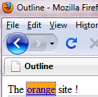
Focus Pseudo-class
The :focus pseudo-class matches any element having keyboard input focus (e.g. form input or a link)
Supported in IE 8, all versions of Firefox, Chrome
a:focus { background: orange; }
Focus occurs only when user tabs to this link,
not when the cursor is moved there.

Slide 73
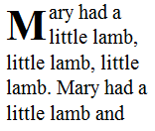
Pseudo-element Selectors
The :first-letter pseudo-element selects the first letter (or digit) of the first line of a text block.
p:first-letter { font-size: 3em; float:left;
font-weight:bold; }
<p>Mary had a little lamb...etc</p>
Rendered in the browser as

Slide 74
Group Selectors
A group of different selectors can share the same style definition – selectors are separated by a comma
h1, h2, h3 { color : blue; }
p, h1, h2 { text-align: left; }
ol, ul { margin-right: 20px; }

Slide 75

Classes vs IDs
Use classes for multiple occurrences of that style in a web page
  Helpful mnemonic:
    class has many students
    ID – the letter I = one
Use ID when there is only one occurrence of that style in a web page

Slide 76
Selector Family Tree
Descendant Selector (the child of the parent)
  div p (p is the child of parent div)
Grandchildren Selector
  Use the universal selector *
div * p (match all paragraphs that are grandchildren or greater of div elements)
Child Selector >
  body > p (match only children p elements of body)
Adjacent Sibling Selector +
em + p (match any p tags that follow after em element)
Attribute Selector [ ]
a[title] (match any a tags having a defined title attribute)

Slide 77
Tags div and span
The div element defines a block-level region which may contain text or other content
<div style="color:blue;">
This is a line of blue text.
</div>
The span element defines an inline region
The Delicious apple
is <span style="color:red;"> red </span>.

Slide 78

Div Element
Nesting elements within a div element
<div style="color:blue;">
<p>This is the first paragraph.</p>
<p style="color:red;">
This is the second paragraph.
</p>
</div>
Note that there are
<p> elements nested
inside this <div> element.

Slide 79
CSS Rule of Proximity
The closer style rule will be applied to text
  Inline style overrides embedded style
  In the case of nested tags (like div), the style rules of the innermost tags override the style rules of the outer tags
    <div style="color:yellow;"> This is yellow.
    <div style="color:green;"> This is green.
    <div style="color:blue;"> This is blue.
    </div> </div> </div>

Slide 80
CSS Rule of Inheritance
Many CSS styles are automatically passed into any child elements from the parent element.
  font and color styles defined for a parent element will be ‘inherited’ by any contained child elements by default
  When inheritance occurs, elements inherit computed values based on the parent and child
body { font-size: 10pt }
h1 { font-size: 120% }
<body>
<h1> Large Heading </h1>
..
</body>
The computed value
of this text will be
10pt x 120% = 12pt.

Slide 81
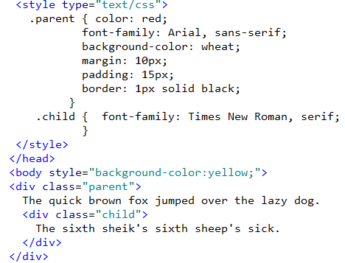
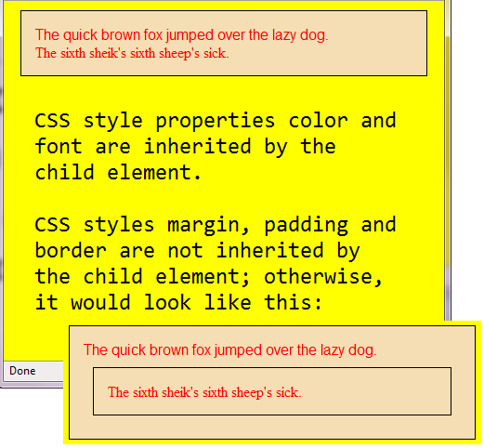
CSS Inheritance

Slide 82
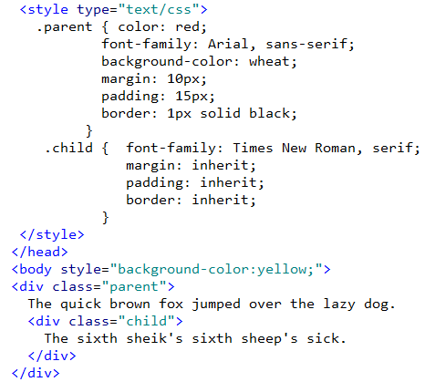
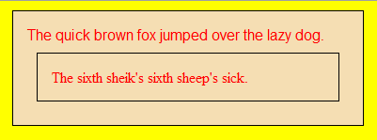
CSS inherit value
CSS properties not normally inherited can be made to inherit with the ‘inherit’ value

Slide 83
Image Clipping
Images can be “clipped” in CSS but only on absolutely positioned elements
img { position: absolute;
clip:rect(0 50 200 0); }
Clip the image start at top edge to 50 pixels to right, 200 pixels to the bottom and 0 to the left
http://www.cs.camosun.bc.ca/~langs/comp140-10/lectures/cssnotes/cssClipExample.html
200
50

Slide 84
CSS Rules
With these rules CSS needs a formula to determine which styles to apply if a selector has a class style, an ID style and an HTML style
<style type="text/css">
#info { color: blue; }
p.note { color: red; }
p { color: green; }
</style>
</head>
<body>
<p id="info" class="note">
This will appear blue.
</p>
</body>

Slide 85
Style Priority
When multiple styles can apply to content, the ID style overrides a class style, and the class style overrides an HTML style
Style defined within the tag’s style attribute overrides all others.
This is relevant only when the same properties are defined; otherwise, the properties are all applied

Slide 86
CSS Rule of Specificity
CSS has rules to determine which selector’s styles will be applied to an element
Each HTML element counts as 1, each class style counts as 10, ID styles count as 100 – highest total wins
<style = "text/css">
div b { color: blue; } ← sum is two (div =1, p =1)
b { color: red; } ← sum is one (p =1)
</style> </head>
<body>
<div>
<b> This will appear blue. </b>
</div>
Because 2 > 1, this text is displayed in
blue not red.

Slide 87
!important rules
You can override any style rule with the !important declaration
p { text-index: 1em !important;
font-style: italic !important;
font-size: 16pt !important }
If these style rules are defined in the user’s style sheet, they will override similar style rules in the author’s style sheet – even if the author used !important as well.

Slide 88
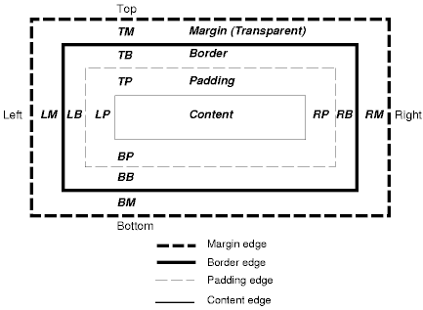

CSS Box properties
CSS box model defines properties such as margin, padding, border, background, position
http://www.cs.camosun.bc.ca/~langs/comp140-10/lectures/cssnotes/CSS_ex06.html
Padding measures
must be non-negative.
Margins are
always transparent.

Slide 89
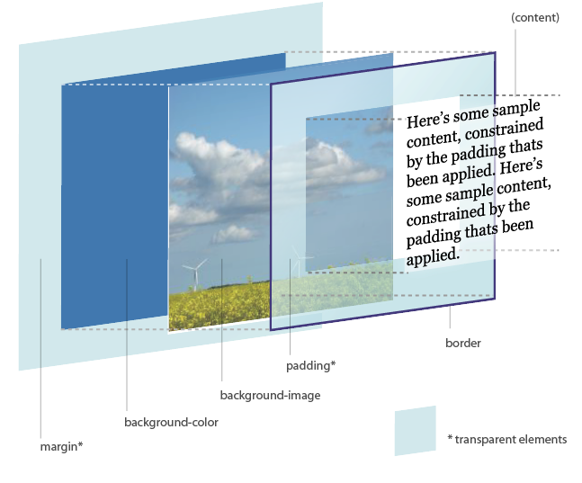
CSS Box model in 3D
Box model example

Slide 90
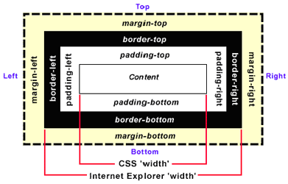
IE box model – quirks mode
In quirks mode IE browsers understand the box model width property their own way:

Slide 91
IE Quirks Mode
Prior to version 6, IE browsers used a different method for determining the width of an element’s box than the method used by the W3C CSS
Many web sites had already used the non-standard Microsoft implementation of width
Quirks mode refers to a technique used by a browser to make an earlier, non-standard W3C web page compatible for viewing
Any later version of IE can be “flipped” into quirks mode if the HTML has a missing Document Type Declaration (the DOCTYPE)

Slide 92
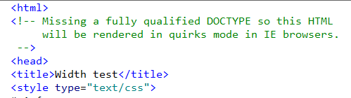
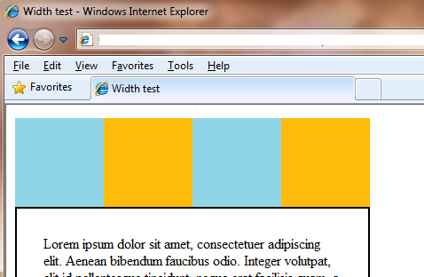
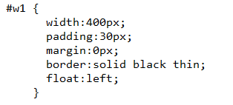
Quirks Mode example
In IE an incorrect or missing DOCTYPE triggers quirks mode

Slide 93
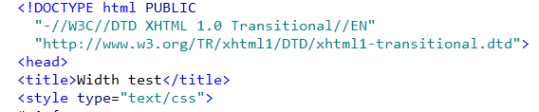
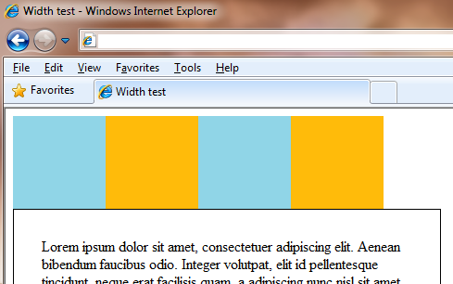
Standards Mode example
IE v8 uses standard box model width if a valid DOCTYPE is defined in the HTML

Slide 94
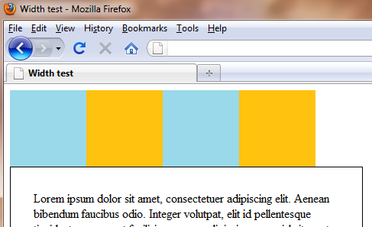
Firefox v3 example
Firefox uses standard box model width whether the DOCTYPE is valid or not

Slide 95
Positional presentation
By default CSS uses normal flow to place elements on the page
Or, elements can be placed relative to other elements (relative positioning)
Or, elements can be allowed to float to the edge of the page
Or, elements can be positioned on the page with (x, y) location (absolute positioning)

Slide 96
Normal flow
Any element not specifying position:absolute or position:fixed and not floated
Block boxes flow vertically starting at the top of their containing block. Inline boxes flow horizontally from left to right.
The vertical margins of adjoining block boxes are collapsed.

Slide 97
Relative positioning
The browser first lays out the element as in normal flow, then the element is displaced by the amount specified by the left or right or top or bottom properties.
#content { border: 1px solid;
position: relative;
left: 100px;
top: 120px;
}
Shifting the content box
to the right by 100 pixels
and down by 120 pixels.

Slide 98
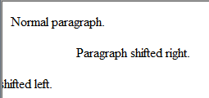
CSS Position property - relative
Relative positioning shifts the referenced item
<style type="text/css">
p.moveright {position: relative; right: -5em;}
p.moveleft {position: relative; left: -5em;}
</style>
</head>
<body>
<p> Normal paragraph.</p>
<p class="moveright">Paragraph shifted right.</p>
<p class="moveleft">Paragraph shifted left.</p>

Slide 99
Fixed positioning
Like absolute positioning but the block does not move when a web page is scrolled as other elements do
#content { position:fixed;
}
Useful for keeping key navigation controls present on screen at all times

Slide 100
CSS Position property - fixed
For items that need to stay at specified coordinates regardless of scrolling (IE7 strict mode and Firefox only)
<style type="text/css">
#stay { position: fixed; left:5px; right:5px; }
</style>
</head>
<body>
<div id="stay"> Fixed in window.</div>

Slide 101
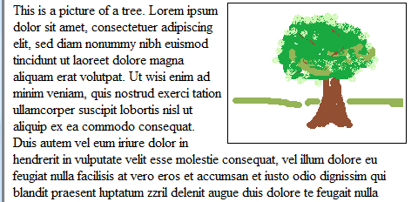
Float property
Float property is usually applied to an image to make it appear to the left or right of surrounding text. You may float block level elements only – not inline elements.
<img style=“float:right” src=“tree.png”> This is a picture of a tree. ...
Recall block level elements are
images, paragraphs, divisions, and
lists. Inline elements include spans
and line breaks.

Slide 102


Float property
top=0 and right=0
bottom and left=10 pixels
Adding in margin property
<img style=“float:right; margin: 0 0 10px 10px” src=“tree.png”> This is a picture of a tree. ...
Adding in padding property and border
<img style=“float:right; margin: 0 0 10px 10px; border: 1px solid; padding: 2px” src=“tree.png”> This is a picture of a tree. ...

Slide 103
CSS Position property - absolute
Position property directs where the item is to appear on the display
Example using absolute positioning:
<style type="text/css">
#layer1 {position: absolute; left:100; top:100; z-index:0;}
#layer2 {position: absolute; left:200; top:200; z-index:1;}
</style>
</head>
<body>
<div id="layer1">
This is layer 1 in the background<br />positioned at 100,100
</div>
<div id="layer2">
This is layer 2 on top of layer 1<br />positioned at 200,200
</div>
http://www.cs.camosun.bc.ca/~langs/comp140-10/lectures/cssnotes/CSS_ex01.html
The z-index property indicates
the stack level for layered effects.
Lower z-index values are on bottom.

Slide 104

CSS Position Absolute

Slide 105
Clear property
CSS property clear indicates which sides of an element other floating elements are not allowed – useful when window is resized
clear : right; /* no floating elements on right */
clear : left; /* no floating elements on left */
clear : both; /* no floating elements adjacent */
clear : none; /* default –
adjacent floating elements allowed */

Slide 106
Display property
The display property controls the type of box an element generates
For example you may want to force some inline elements into block elements
a.menu { display: block; }
h1 { display: inline; }
p.newad { display: inline-block; }
div.rem { display: none; }
inline-block makes the element generate a block box that is
laid out as if it were an inline box. None means no display.

Slide 107
Lists
Applies to the list item element for unordered and ordered lists
list-style-type can be disc, circle, square, decimal, lower-roman, upper-roman, lower-alpha, upper-alpha, none
list-style-image can be none or a URL value
list-style-position can be inside or outside
http://www.cs.camosun.bc.ca/~langs/comp140-10/lectures/cssnotes/CSS_ex02.html

Slide 108

List style type
List style types can
be alphabetic,
numeric, or symbols

Slide 109
Cursors
Cursor property specifies the type of cursor to display when pointing on an element
cursor can be default (arrow), crosshair, pointer, move, url, text, wait, help
cursor can also be e-resize (resize left-right), n-resize (resize up-down), nw-resize, ne-resize, se-resize, sw-resize
http://www.cs.camosun.bc.ca/~langs/comp140-10/lectures/cssnotes/CSS_Cursors.htm

Slide 110


Outlines
It may be appropriate to provide an outline surrounding a visual object like a button or an active form field to make them stand out

Slide 111


Outlines

Slide 112


Overflow
When text won’t fit the size of the given box, what do you want happen?
overflow: scroll
overflow: hidden
overflow: auto
Hidden means
any overflow is clipped.
Visible is the default
any overflow is not
clipped.
overflow: visible
http://www.cs.camosun.bc.ca/~langs/comp140-10/lectures/cssnotes/overflow.htm

Slide 113
Overflow CSS3
overflow-x overflow-y
Overflow-x determines clipping at the left and right edges (scrollbar is horizontal)
Overflow-y, at top and bottom edges (scrollbar is vertical)
CSS3 has defined an overflow-style but no browser supports this property yet

Slide 114

Firefox Error Console

Slide 115

CSS Errors Example
link
Incorrect value name, should
be middle.
Incorrect property name, should be font.
Incorrect location
for link element.
Nonzero CSS values
should include the
measure (e.g. em or px)
Incorrect property name, should
be color. Unknown property name abc

Slide 116

CSS Errors caught by Firefox

Slide 117


Microsoft Internet Explorer Developer Toolbar

Slide 118

W3C Unified Validator
Checks HTML,
CSS, and RSS
for compliance
to the standard
grammar rules.

Slide 119
Review CSS Questions

Slide 120
References
http://www.w3.org/TR/CSS21/cover.html
http://www.devwebpro.com/9-top-css-essential-skills-that-every-web-designer-should-learn/
http://dba.med.sc.edu/price/irf/Adobe_tg/models/hsb.html (HLS information)
http://www.impressivewebs.com/css-opacity-reference/
http://www.hicksdesign.co.uk/boxmodel/

