Slide 1
HTML Form Structure

Slide 2
HTML Form
A form structure is a practical method for collecting information from the user
Forms on a web page are set up using a combination of HTML form tag elements and an associated script written in PHP, ASP, Perl, python, or other script language
Scripts are commonly called CGI (Common Gateway Interface) and run on the web server

Slide 3
ISP Script
Many Internet Service Providers supply pre-built CGI scripts to allow customers to use them in their HTML documents
Useful for collecting email addresses, personal info, ordering products, etc
Normally a CGI script does not have any access to the client computer

Slide 4
HTML v4 form elements
HTML v4 form elements (called controls) include
  Input boxes for text and numeric values
  Radio buttons, also called option buttons to select a single option from a predefined list
  Selection lists for longer lists of options in a drop-down listbox
  Check boxes to specify an item as either being selected or not selected
  Text areas for longer amounts of text
  Submit button to submit the updated form data to the CGI script
  Reset button to reset the form to its original state

Slide 5
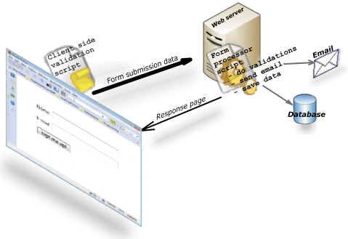
HTML form
Each form element in which the user can enter information is called a field
Information entered into a field is called the field value, or simply the value

Slide 6
HTML form
Form elements have attributes
  name , used to associate the form control’s current data when it is sent to the server
  id , used to uniquely identify a form control in the DOM and associate a label (optional)
  value , used to provide an initial value to a form control (optional)
  <label for="fname">Enter name:</label>
  <input type="text" name="firstname" id="fname" value="Your first name">

Slide 7
Form tag
The <form> element includes properties that control how the form is processed, information on which CGI script is used, how the data is transferred to the script
<form name = "myForm"
action = "script name"
method = "method name" >
... form elements
</form>

Slide 8
Form tag
A form structure may not be defined inside an existing form structure
Multiple forms may be defined in a page but each form should have a unique name attribute value
Form names should not contain spaces
Omitting the form tag’s action attribute will not break the form but will mean nothing happens when user clicks on the Submit
Form controls must be defined inside the <form> element

Slide 9
TextArea
A field for entering multiple lines of information
By default, the shape is a blank field of four lines and 40 characters wide
Name attribute required
To control how the text is wrapped in a text area, use the wrap attribute (soft is the default)
  wrap="off" turns off text wrapping
  wrap="soft" or "virtual" turns text wrapping on but does not send text wrapping data to web server
  wrap="hard" or "physical" turns text wrapping on and also sends text wrapping data to web server

Slide 10
TextArea Form Element
<form name="myForm" ... >
<textarea name="comments"
rows="4"
columns="40">
</textarea>
</form>
Defines a text area in the form with four lines and 40 characters wide

Slide 11
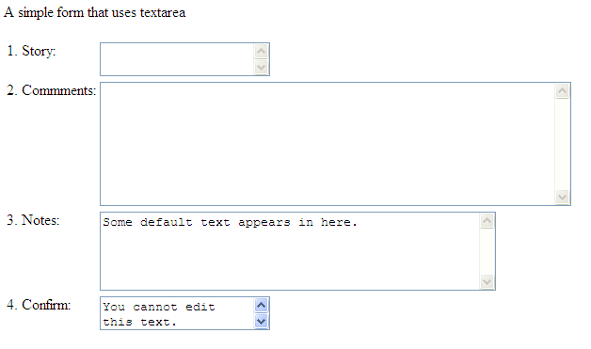
HTML Textarea example
Page sample
Page sample CSS enhanced

Slide 12
Select Form Element
Has two parts: <select> tag and <option> tag
Shows a list of options in either a pop-up menu or a scrolling list
Number of options to show use size="n"
Multiple selections use multiple="multiple"
Preselect options with selected="selected" in the option tag

Slide 13
Select
<select name="payment">
<option selected="selected"
value="credit">Credit Card
</option>
<option value="debit">Bank Debit
</option>
<option value="cheque">Cheque
</option>
</select>

Slide 14
Select optgroup
Items can be grouped into a separate submenu
<optgroup label= "Province">
<option value="BC">BC </option >
<option value="AB">Alberta </option >
</optgroup>

Slide 15
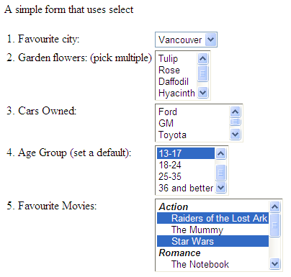
HTML Select example
Page sample
Page sample CSS enhanced

Slide 16
Input Form Element
Unlike textarea and select elements the input element has a single tag
Used for text box, check boxes, radio buttons, passwords, and many other form element types
Attributes:
  name, the name of the data field
  size, the length of the field in characters, default is 20
  maxlength, max number of input characters to accept
  value, usage depends on the type of input element

Slide 17
Input Form Element
value attribute, if the input element type is text or password, this is the default text to display; for checkbox or radio button, this is the value returned to the server; for submit and reset buttons this is the text to show inside the button
checked attribute, sets a radio button or check box to "on" – usage: checked="checked"

Slide 18
Input Element – text type
Type attribute
  Text, default value for type attribute, the text type is used in cases a type is specified unknown by the browser (e.g. HTML 5 has new input types like tel and email), this form element accepts text from the user
  <input name="firstname">
  <input type="text"
  name="phone"
  size="15"
  maxlength="12">
  <input name="country"
  value="Canada">

Slide 19
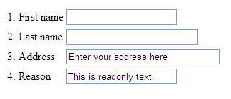
HTML Input text example
Page sample
Page sample CSS enhanced

Slide 20

Input Element – password type
  password, a type of text field but the user’s typed characters are shown onscreen as bullets to prevent echoing of characters – this is not encrypting the data sent to the server
  <input type="password"
  name="password"
  size="30"
  maxlength="30" >
Sample page
Sample page CSS enhanced

Slide 21
Input Element – checkbox type
  checkbox, a switch control is "on" when its checked attribute is set (e.g. checked="checked" )
  checkbox controls within the form may share the same name value
    Zero, one, or many selectable options
    Can make them preselected with checked="checked"
    To make PHP scripts work easier place [] at the end of the name attribute
    If value attribute is not provided, then either 0 or 1 is used

Slide 22

Checkbox example
  <input type="checkbox" name="os[]"
  value="unix"> Unix
  <input type="checkbox" name="os[]"
  value="Win" > Windows XP
  <input type="checkbox" name="os[]"
  value="Mac"
  checked="checked">Mac OS
Sample page
Sample page CSS enhanced

Slide 23
Input Element – radio button type
  Allows only one option selected
  All the radio elements must have same name attribute
  Can supply optional checked="checked" to preselect as the default
  <input type="radio" name="user" value="home"> Home
  <input type="radio" name="user" value="business" checked="checked" > Business
Sample page
Sample page CSS enhanced

Slide 24
Input Element – hidden type
  Creates an undisplayed field in the form
  Used to send calculated or some default value information to the server when form data is submitted
  <input type="hidden" name="IM" value = "smmh@hostmail.com">

Slide 25
Input Element – reset type
  Displays a push button with the present function of clearing all the data in the form back to its original state
  Name and value attributes are optional unless there is more than one reset button
  Value attribute can be used to show text in the reset button
  <input type="reset">

Slide 26
Input Element – submit type
  Displays a push button with the preset function of sending the entered data in the form to the server for processing
  Value attribute defines what text to show in the button
  Name and value attributes optional unless there is more than one submit button
  <input type="submit" value= "Click here to download" name = "download">

Slide 27
Input Element – image type
  Can be used to act like a submit button
  Rarely used anymore, think imagemaps
  The data name.x coordinate and value.y coordinate are passed to the script
  <input type="image" src="CanadaMap.png" name="CANADA" value="Province" >

Slide 28
Input Element – file type
  Used to upload a file to the web server
  Useful when submitting a document created by another program such as a spreadsheet
  <input type="file" name = "reports.xls" />

Slide 29
Form Action Attribute
The <form> tag uses an action attribute
  Specifies the name of the script to run when the form’s submit button is clicked
  If no action attribute is provided, or the script does not exist, nothing will happen when submit is clicked
  CGI scripts are usually organized into their own folder sometimes called script or cgi-bin
  <form name="myform" action="script/runform.php" >

Slide 30
Form Method Attribute
Method attribute controls how your browser sends data to the web server
  Get method is default. This sends the form data as a complete text appended to the URL. All the form data are shown in the URL separated by ampersands
http://www.myscript.com/....cgi?name=John+Smith&email=jsmith@mail.com
  Post method is preferable. This sends the form data in a separate data stream and is more flexible as some web servers will truncate the amount of data they receive from the GET method

Slide 31
Form Enctype Attribute
Specifies the format of the data when it is transferred from the web page to the script
Default value is either ‘multipart/form-data’ (for type="file") or ‘application/x-www-form-urlencoded’ (all other types)
text/plain for HTML 5
Tells the server what type of data it should be expecting from the browser

Slide 32

Organizing Form Elements
You can group different form components into a related group called a fieldset
Makes it easier for visitors to the page to understand the form and fill it out properly
The legend tag is descriptive text
<fieldset>
<legend>Personal Information</legend>
... Rest of form elements
</fieldset>

Slide 33
Form Label
Label tag enables CSS formatting to the form elements
<label for="fname">First Name: </label>
<input type="text" name="firstname"
size="15" id="fname">

Slide 34
Tab Order
Tabindex attribute changes where pressing the tab key while in the form moves the focus
Lower numbered tabindex elements get the focus first
Tabindex values can range from 0 to 32767
<input type="text" name="firstname" tabindex="3">
<input type="text" name="lastname" tabindex="6">

Slide 35
Disabling Form Elements
Any form element can be made initially unavailable to the user with disabled="disabled" in the form tag
The form element will appear grayed out
Disabled controls do not receive focus
Disabled controls are skipped in tabbing navigation
Can use Javascript code to re-enable or dynamically disable form elements

Slide 36
Accesskey Attribute
The accesskey attribute works with the tags label, a, and caption for defining a case-insensitive "hotkey" for making an element have focus (declared obsolete for HTML 5)
<label accesskey="n">Name<input type="text" name="user"> </label>
- makes alt-n give focus to this form field

Slide 37
Readonly Attribute
For textarea, text and password form elements
Prevents user input into those fields having the readonly attribute defined
Readonly elements can receive focus but cannot be modified by the user
Readonly elements are included in tabbing navigation
<input type="text" name="dept" value="T2EH-QW" readonly="readonly" />

Slide 38
Title Attribute
Allows for tool-tips pop-up
Provides meaningful explanation or a short description of an element
<input type="text" name="dept" title="Department Category" />

Slide 39
Button tag
User defined image buttons
Define an onclick attribute and an image
<button onclick="script/mybutton.php">
<img src="bluebutton.png" />
Click this blue button.
</button>

Slide 40
HTML5
New form elements and attributes in HTML5
Not supported by all browsers – features degrade nicely (e.g. they become text boxes)
<input type= "tel"> for phone numbers
  <input type= "number"> numbers only
  <input type= "search"> search box (like text)
  <input type= "email"> email address
  <input type= "url"> for url addresses
  <input type= "date"> for date information
  <input type= "color"> for colour selection

Slide 41
HTML5
New form elements
  <progress> shows progression along a set of tasks
  <meter> a scalar measurement within a range
  <datalist> for making options within a dropdown
  <keygen> a control for key-pair generation
  <output> shows the output of a calculation

Slide 42
HTML5 - progress
Show a progress bar to indicate progression along a sequence of tasks
Use the orient property to specify horizontal (default) or vertical display
Use JavaScript to dynamically update
<progress value="70" max="100">
70 %</progress>

Slide 43
HTML5 - meter
The meter element is similar to progress but meter shows the status of a value within a range (ideally between a min and max)
<meter min="200" max="500" value="350"></meter>
<meter low="69" high="80" max="100" value="84"></meter>
<meter low="69" high="80" min="50" max="100" value="60"></meter>
value is between min and max ☺
value is > high ☹
value is < low ☹

Slide 44

HTML5 - datalist
Use datalist to define a predefined set of valid entries to a text box (not supported by Safari)
<datalist id="soup" >
<option value="chicken">
<option value="minestrone">
<option value="tomato">
<option value="miso">
</datalist>
Enter your soup: <input name="sel" list="soup" >

Slide 45
HTML5 - keygen
The keygen form element creates a public key as part of HTML form to be used for web-based certificate management systems (encrypt the form information)
Microsoft does not support this element http://support.microsoft.com/kb/190282
PHP script can access the local private key stored within the browser certificate area

Slide 46
HTML5 - output
The output element represents the result of a calculation
<form oninput=
"result.value=parseInt(a.value)
+parseInt(b.value)">
0<input type="range" name="b" value="50">100
+ <input type="number" name="a" value="10">
= <output name="result"></output>
</form>
some DHTML here ☺

Slide 47
HTML5
Attributes for the <input> element
  placeholder – shows a light coloured hint of input
  autofocus – focuses on element when page is loaded
  required – if present, the element cannot be left blank by user when submit is clicked
  pattern – the input data must match the provided regular expression
  autocomplete – default is on, set it to off for elements you don’t want autofilled (credit card)

Slide 48
HTML5
The pattern attribute specifies a regular expression:
  \d indicates a single number 0 to 9 same as [0-9]
  \d{3} indicates exactly three digits
  \d{4,7} indicates min 4 max 7 digits are needed
Use title attribute to let users know input
Special characters like hyphen, (, and ) are enclosed by square brackets preceded by \
  [\-] or [\(] or [\)]

Slide 49
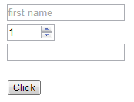
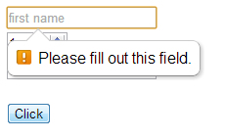
HTML5
<input type= "text" placeholder= "first name"
required>
<input type= "number" value="1" min="1" max= "10">
<input type= "tel" pattern="\d{7}" >

Slide 50
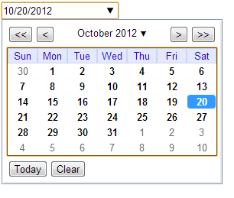

HTML5
<input type="date"> works in Chrome, Opera but not yet in Firefox or IE

Slide 51



HTML5
<input type= "range" name="skill" min="1" max= "10" value="1">
<form oninput= "amount.value=rangeInput.value">
<input type="range" id="rangeInput"
name="rangeInput" min="0" max="100">
<output name="amount" for="rangeInput">0
</output>
</form>

Slide 52
HTML5
Other date and time variations … implemented in the Opera browser only
<input type= "datetime">
<input type= "month">
<input type= "week">
<input type= "time">
<input type= "datetime-local">

Slide 53
HTML5
<input type="email">
  If attribute multiple is specified, two or more email addresses can be entered separated by commas
  User must enter an address having an @ symbol

Slide 54
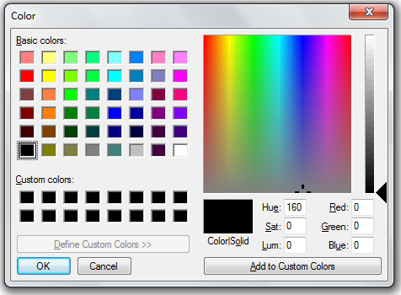


HTML5
<input type="color">
<input type="range" min="-100" max="100" value="0" step="10" name="power" list="powers">
<datalist id="powers">
<option value="0"> <option value="-30">
<option value="30"> <option value="+50">
</datalist>

Slide 55

Spell Checking
Text fields can be spell checked using HTML 5 spellcheck attribute
Based on the lang attribute in <html>
<html lang="en"> means use English spelling
<textarea spellcheck="true"> </textarea>
<input type="text" spellcheck="true">

Slide 56
CSS3
pseudoclasses :invalid and :required can be styled in CSS
:invalid {
box-shadow:0 0 5px rgba(255, 0, 0, .8);
border-color: red;
}
:required {
box-shadow: 0 0 5px rgba(0, 0, 255, .5);
border-color: blue;
}

Slide 57
Form design guidelines
Form field descriptions on the left, alignment
Label input boxes with clear instructions
Group related form items into a fieldset
Control user’s entries with radio buttons, checkboxes and selection lists whenever possible
Let users know the correct format to enter date fields (yyyy/mm/dd)
Use selection lists for many possible options
Use radio buttons for five or fewer options

Slide 58
Form Anomalies
Can a form prevent users hitting submit twice?
  Can’t -- unless you use cookies or use a unique ID in the form
Some form elements can be easily styled with CSS (form, fieldset, label, input, output) – other form elements not so easily (date, select, option, progress, meter, legend)

Slide 59
HTML Forms
Mozilla Developer guide HTML forms https://developer.mozilla.org/en-US/docs/Web/Guide/HTML/Forms

