Slide 1
Image File Formats

Slide 2
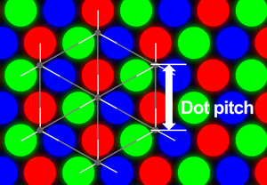
Monitor Resolution Measure
For monitors using red, green, blue subpixels, the DPI (dots per inch) should measure the pixel resolution (not the subpixels)
Less misleading is the term pixels per inch (PPI)
Dot pitch is a measure of the distance between the subpixels
A lower dot pitch is good,
higher PPI is good
Good LCD monitors display
.27mm dot pitch with 94 PPI

Slide 3
Video Card Resolution Measure
Not the same as monitor resolution
PPI is influenced by the monitor’s display dimension (the diagonal) and the video card display resolution (video standard used)
Video display standard | Video card resolution | Usual monitor size (diagonal)
XGA | 1024 x 768 | 14”-15”
SXGA | 1280 x 1024 | 17”, 19”
UXGA | 1600 x 1200 | 20”, 21.3”
WSXGA+ | 1680 x 1050 | 20”-22”
WUXGA | 1920 x 1200 | 23”-28”
WQXGA | 2560 x 1600 | 27”-30”
WQUXGA | 3850 x2400 | 56”-64”

Slide 4
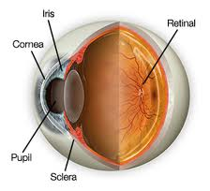
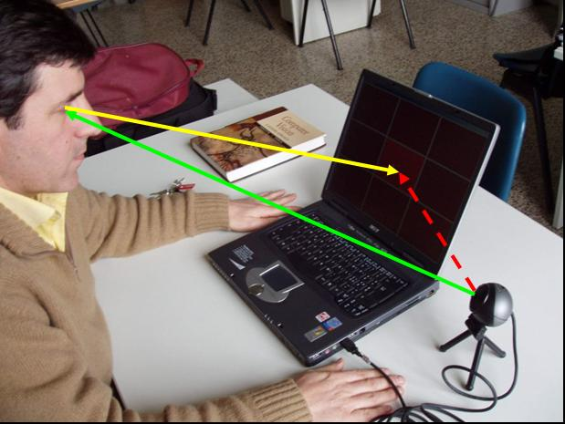
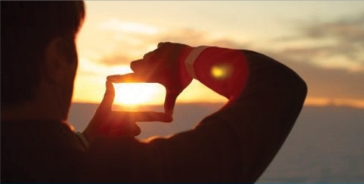
Human Vision Resolution Measure
The human eye can handle roughly 576 megapixels of image data (conservative estimate because our eyes are constantly flicking around to cover a larger view area)
120 degrees horizontal and 60 degrees vertical

Slide 5
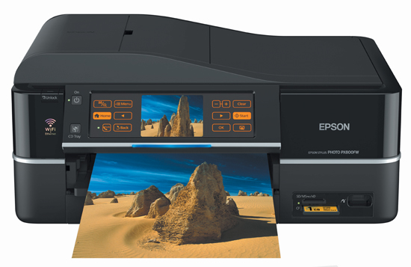
Print Resolution Measure
Printers have a much higher resolution than screens
Printers can manage 300 dpi – 9600 dpi
People hold paper closer and expect more text information reading paper
Print 5” x 7” picture, recommend minimum of 575 x 805 pixels
For 8.5” x 11”, minimum
775 x 1000 pixels

Slide 6
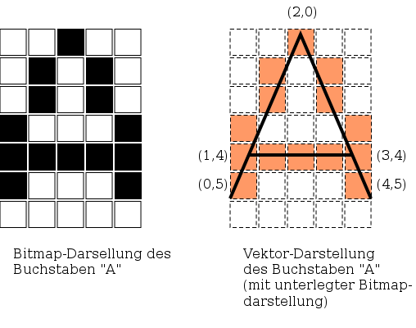
Images
Pictures are stored on computer in either of two ways: bitmap or vector
Bitmap format stores information about the pixels (dot) in the image
Vector format use
formulas to show the
lines and edges within
the image

Slide 7

Bitmap
Also called raster
The image is represented as a grid of dots – each dot is one colour
More dots =
bigger image size
Windows 7 desktop
icons are typically
48 pixels x 48 pixels

Slide 8
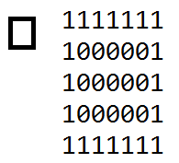
Bitmap – colour depth
Each dot in the image can be represented by one of several colours
The number of different colours in the image determines the size of the image file
If the image consists of only
black and white (two
different colours), then
each dot can be a zero for
white and one for black
(one bit)

Slide 9
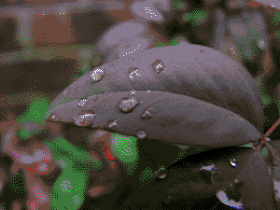
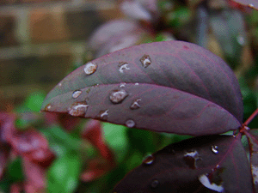
Bitmap – colour depth
If the image contains 16
unique colours, then each dot
can be one of 16 values or
some code between 0000 and
1111 (16 combinations) – need 4 bits per dot
If the image contains 256
unique colours, then 8 bits
(1 byte) per dot are needed

Slide 10

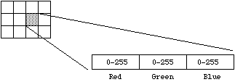
Bitmap-colour depth
Truecolor is the term for photo-realistic images having 24 bits (3 bytes per red/green/blue combination) per dot
16.7 million colours possible
256 levels of red x
256 levels of green x
256 levels of blue

Slide 11
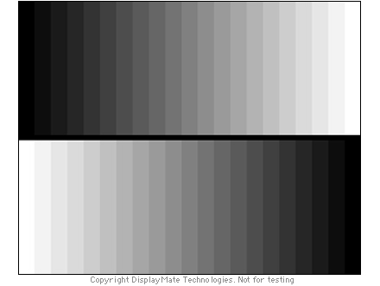
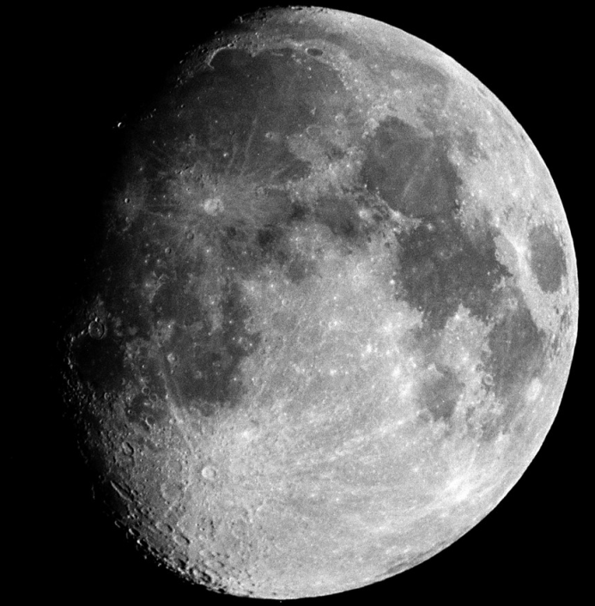
Grayscale
Grayscale images have not just white and black but many shades of gray in between
Also called monochromatic

Slide 12
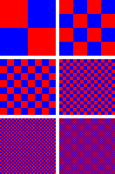
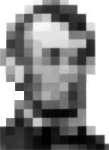
Dithering
Where a colour palette is limited,
dithering is a technique for creating
the illusion of colour depth
Human eyes tend to combine two
colours that are close together
Reducing the colour depth of a
photograph will lose detail

Slide 13
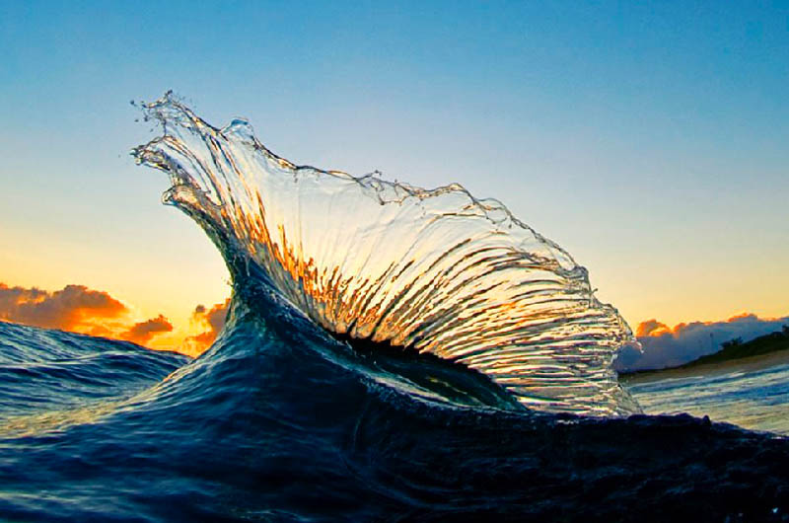
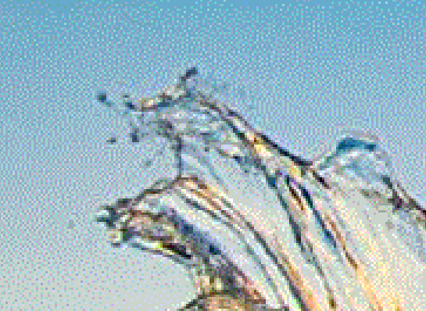

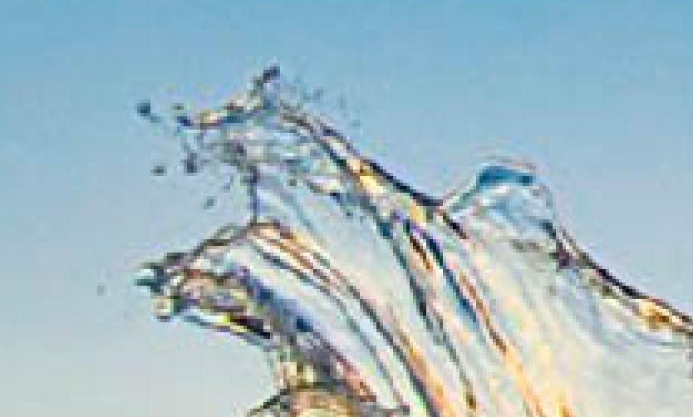
Dithering
Original JPEG
Dithered as GIF

Slide 14

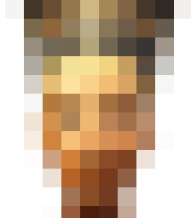

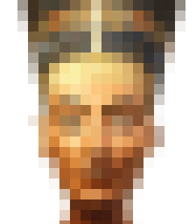
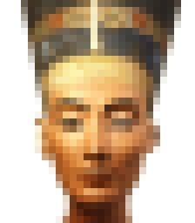



Bitmap file size
Photo-realistic images are much larger in digital storage size because of the greater number of bits or bytes needed per dot in the image
Downloading large files can be slow and tie up network resources
Compression technologies
reduce the size of the image
file in some cases by 90%

Slide 15
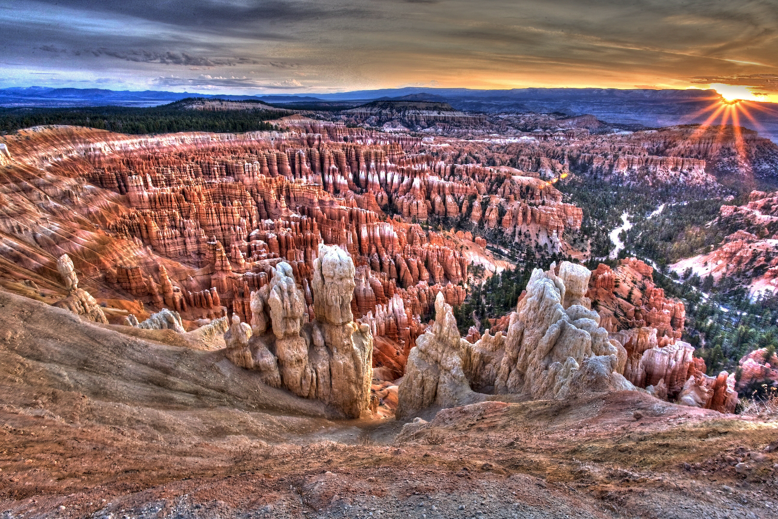
JPEG image size 1.6 Mb
No compression
1400 x 935 pixels 96 dpi

Slide 16
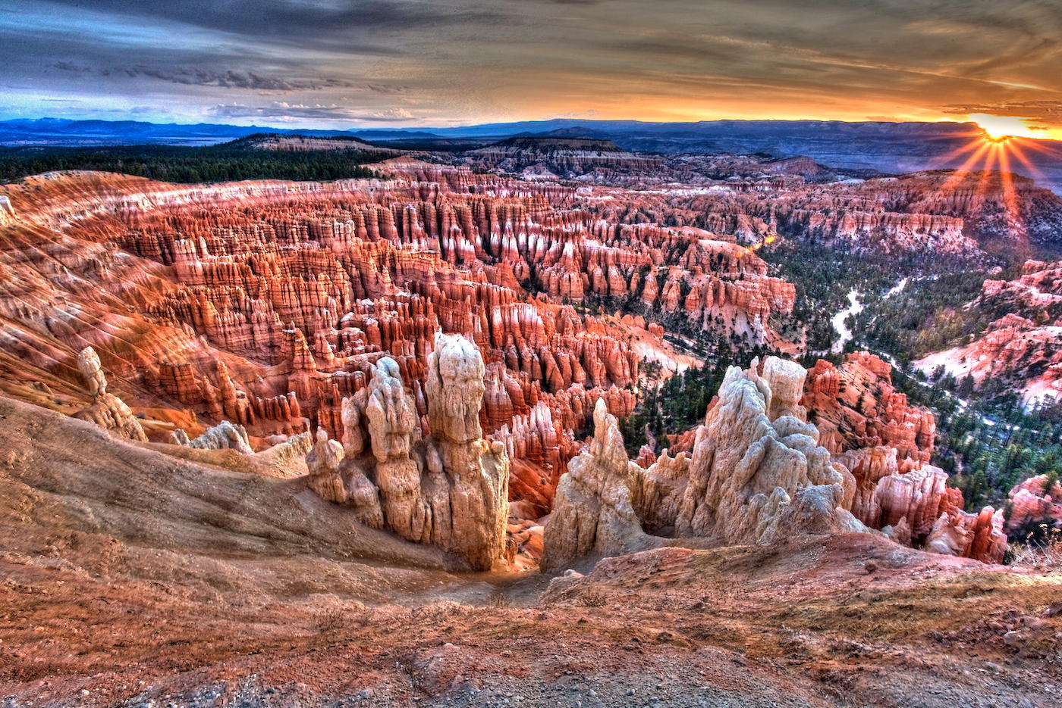
JPEG image size 378 Kb
1400 x 935 pixels 72 dpi

Slide 17

JPEG image size 252 Kb

Slide 18
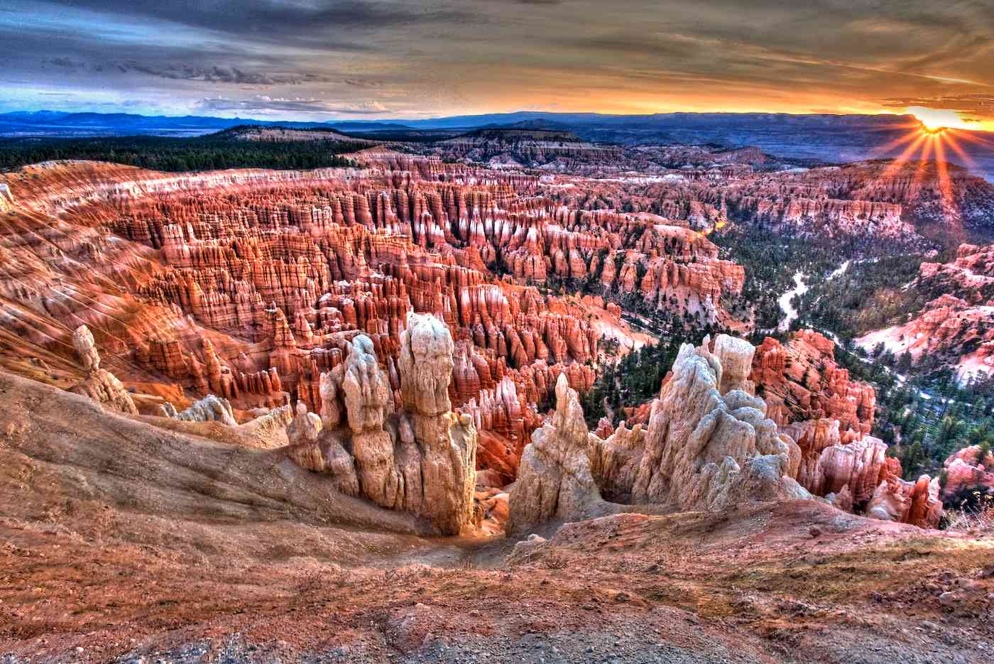
JPEG image size 171 Kb

Slide 19

JPEG image size 104 Kb

Slide 20

JPEG image size 61 Kb

Slide 21


Anti-Aliasing
Bitmap images, when scaled up in size, may appear to have jagged edges
Anti-aliasing is the technique of minimizing the effect of these blocky appearances
Video processor may use subtle changes in colour around the curve or edge

Slide 22
Bitmap compression
Some common bitmap formats:
  Bmp – Windows Bitmap (best quality, large file)
  Gif – Compuserve Graphic Interchange Format (max 256 colour palette, lossless format, small file, animation, proprietary, pronounced “jiff”)
  Jpeg – Joint Photographic Experts Group (lossy format, large file, no transparency)– Jpeg 2000 supports lossless and lossy
  Png – Portable Network Graphic (open source, true colour, small file, lossless)
  WebP – Google’s image format to supersede JPG (lossy format, open standard, true colour)
  Pcx – Personal Computer eXchange (uses RLE)
  Psd – Photoshop Document
  Tiff – Tagged Image File Format (printing industry, uses RLE)

Slide 23
Compression - RLE
Run length encoding (RLE) is a lossless compression technique
Rather than store a long sequence of the same colour on a row, store the count of that colour instead
E.g. becomes 7B
1B5W1B
1B5W1B
1B5W1B
7B

Slide 24
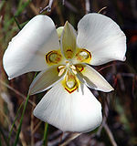

Lossless and Lossy
Jpeg performs compression through interpolation of adjacent pixels’ colours (e.g. substitute image subgrids with a single colour block)
Can create visual artefacts / blurring in images having a long straight edge (e.g. building against sky) – noticeable when zooming or scaling
Typically 10:1
compression with little
loss in quality

Slide 25
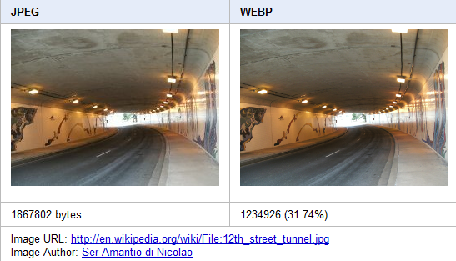

When to use
Use Png for images having transparent backgrounds and smooth or blending edges
Use Gif JavaScript for small, animated images
Use Jpeg for large, photorealistic images
Google’s Webp (webby) may supplant Jpeg at some point
GIF89

Slide 26
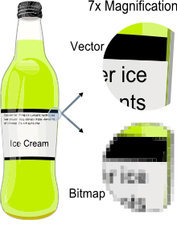
Bitmap vs Vector
When scaled, bitmapped
images lose clarity while
vector images can be scaled
without any loss of quality
It is easier to convert
a vector image into a bitmap
equivalent – more difficult
to convert a bitmap to a
vector image.

Slide 27
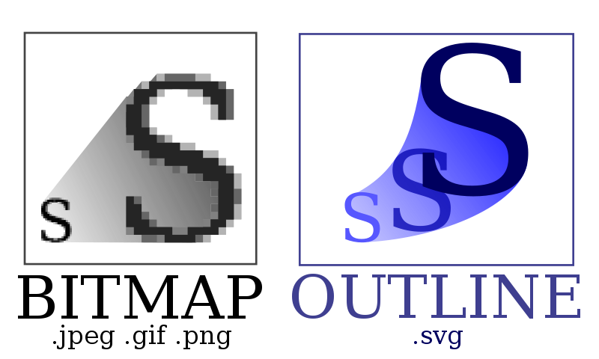
Vector format
Vector image formats describe the image as geometric lines, curves and formulas
Significant space saving compared to bitmap especially if the image is large
SVG (Scalable
Vector Graphics) is
an image format
that supports both
vector and raster

Slide 28
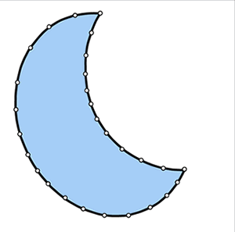
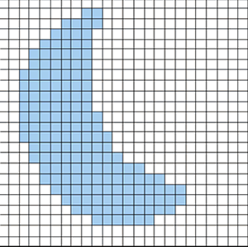
Vector format
SVG is an open standard by W3C (1999)
Images are expressed as XML text
Other vector type images
  Adobe Illustrator
  CorelDRAW
  Encapsulated PostScript
  OpenDocument Graphics
  Portable Document Format (PDF)
  Shockwave Flash

Slide 29
Questions?

Slide 30
References
http://www.infobyip.com/detectscreenresolution.php
http://en.wikipedia.org/wiki/Graphic_display_resolutions
http://www.michaelbach.de/ot/fcs_mosaic/index.html
http://www.htmlgoodies.com/tutorials/web_graphics/article.php/3479931

