Slide 1
HTML Basics

Slide 2
Goals
Understanding of:
  origin of HTML
  hyperlink definition
  how HTML elements are constructed
  HTML document structure
  simple HTML elements

Slide 3

Can you see the Large Hadron Collider?
It is underground but here is where the web was born !
CERN lab in Geneva, Switzerland

Slide 4
Origin of HTML
At the Swiss CERN lab ...
During late 80’s the lab needed an electronic system for researchers to share research documents and data
In 1990 British physicist Tim Berners-Lee, working at CERN, develops HTML and writes the first web server and browser software – Christmas Day 1990 HTML is alive
The design of HTML was influenced by a type of SGML, Standard Generalized Markup Language
SGML markup describes a document’s structure such as its paragraphs, quotations, and attributes like author
Berners-Lee wanted one electronic ‘web’ for everyone to use, regardless of computer, software, or document

Slide 5
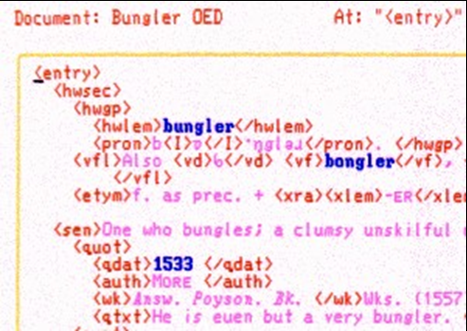
SGML
SGML tags look like this: <auth>More</auth>
This is the
start tag.
This is the
end tag.
The tag’s name is auth. The
colours green and red are just
used here to show the tags.
The text between the
start and end tags make
what’s called ‘content’ or
the ‘important stuff’.
How many SGML tags do you see here?
End tags always have the
forward slash / in front
of the tag name.

Slide 6
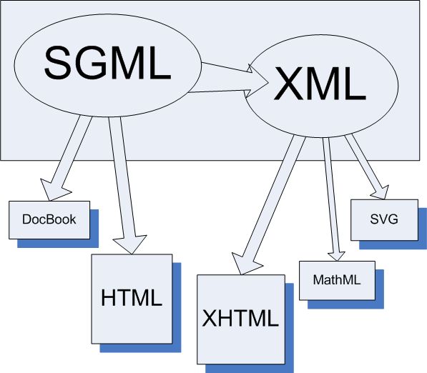
SGML to HTML
SGML can be
thought of as the
‘ancestor’ for
many internet
technologies:
  HTML
  XML
  XHTML
  SVG

Slide 7
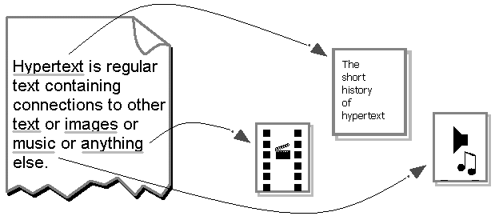
Access content on the Web
Accessing cross-referenced documents, known as hypertext linking, is an important aspect of the Web because it allows your browser to quickly access content on the Web:
  page text
  audio and video
  programs
  images
  social network site
HTML document

Slide 8
World Wide Web
Within an HTML document are usually found hypertext links, or hyperlinks, which are references to other internet resources such as HTML content.
That referenced content can be a resource stored anywhere on the Internet on another web site.
The web server type (e.g. Apache, Microsoft IIS) which is hosting that content doesn’t matter to the browser
When you “click” the hyperlink in the browser, the information referenced by the hyperlink is displayed to you either from the browser’s cache or from where ever on the internet that information is stored.

Slide 9
HTML Documents
In the early to mid 1990’s it was common to use a text editor to create HTML documents
Hypertext Markup Language (HTML) is a simple markup language used to create HTML content (or ‘web pages’)
HTML is not a programming language

Slide 10
HTML Documents
A markup language is a set of characters or symbols which define a document’s logical structure.
<title> A Tale of Two Cities </title>
<quote> It was the best of times. It was the worst of times. </quote>
<address> 48 Doughty Street London WC1N 2LX </address>
These are markup tags.

Slide 11
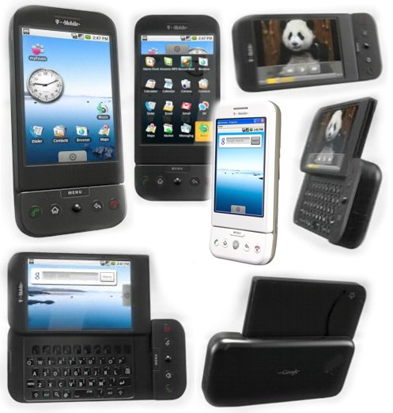


HTML Documents
A target output format refers to the medium in which a document will be displayed, such as a Web page, mobile device, or a printer

Slide 12

Before the W3C
In the 90’s web page authors began to find it necessary to write customized HTML code for each web browser vendor (e.g. Microsoft Explorer, Netscape Navigator).
Each browser vendor supported its own “flavour” of HTML (the so-called ‘extensions’) to gain market share through enhanced capabilities (e.g. multi-column text layout like a magazine or newspaper).
Browser-specific extensions to the HTML = more work needed to maintain and develop new web pages

Slide 13

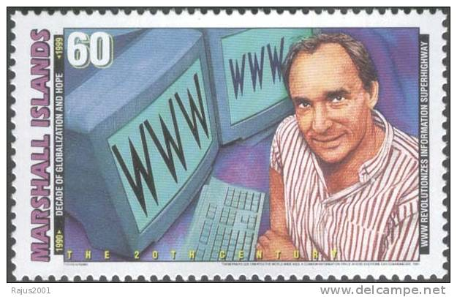
The W3C
To address the growing need for web page standards, Tim Berners-Lee established the World Wide Web Consortium, or W3C, in 1994 at MIT to oversee the development of Web technology standards

Slide 14





The W3C
The W3C does not release a version of a particular technology. Instead, it issues a formal recommendation for a technology, which essentially means that the technology is (or will be) a recognized industry standard
RDF
SOAP
SVG
HTML
CSS
HTTP
XML
DOM
Semantic web

Slide 15
Basic HTML Syntax
HTML documents are text documents consisting of:
  instructions called tags or more precisely, ‘elements’
  and the text to display on a Web page
Most HTML elements have a start and end tag
<html> … </html> <p> … </p>
Some HTML elements use just the start tag…
<img> <hr>

Slide 16
HTML Tag Usage Rules
HTML elements define text format, content structure, and form controls allowing user input
Tags are enclosed by angle brackets < >
Tags are not defined inside of another tag (e.g. <b <i>> is not well-formed HTML)
No spaces after the opening bracket for the start tag ( e.g. < b> is not well-formed HTML) and no spaces before the closing bracket
HTML tag names can be either upper or lowercase but by convention use lowercase <BODY> = <body>

Slide 17
HTML Tag Errors
In the event the web page has HTML problems, like a missing end tag or a misspelled tag name, the browser attempts to handle it but the display results may not be what you expect.
In most cases browsers will not ‘crash’ on an HTML error (also called a ‘parse error’).
Best practice: double check the web page HTML using a free online verifier
http://validator.w3.org
or using Adobe DreamWeaver

Slide 18
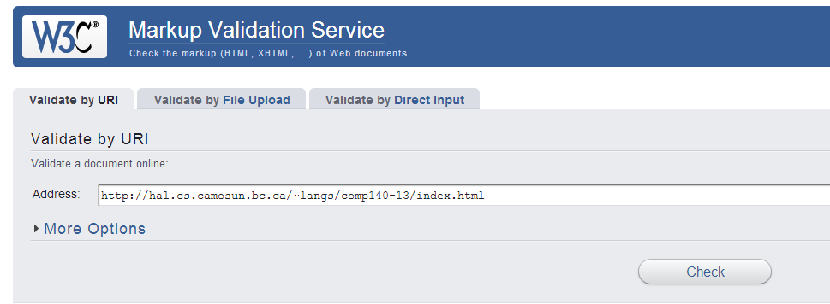
HTML Validation
Validator.w3.org
Type in your web page address to have the
HTML checked for correctness.

Slide 19
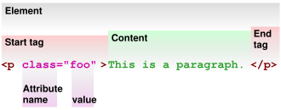
HTML element

Slide 20
Parents and Children
HTML elements are parents to their contained HTML elements
Also called nesting, example:
<body>
<p>The sky is a hazy shade of
<b> winter</b>
</p>
</body>
The body element is the parent to the p element. The b element is a child of the p element. Because the p element is inside the body element, we say the p element is ‘nested’ inside the body element.

Slide 21
XHTML Syntax
XHTML = eXtensible HTML, just like HTML but with strict rules how tags are used
XHTML tag names should be in lowercase – browsers will happily accept tags defined as <B> instead of <b> but the more accepted practice is lowercase.
More on this in a later class…

Slide 22
Basic HTML Syntax
HTML documents are free-format, meaning that any amount of white-space within the content (blank lines, tabs, spaces) will be ignored by the browser display.
HTML content begins with the start tag <html> and ends with the end tag </html>
Two other important HTML structure elements are the <head> element and the <body> element

Slide 23
HTML file name
An HTML file will usually have an extension of .html or .htm (predefined, static HTML page)
e.g. index.html or main.htm
But not necessarily, sometimes HTML content is created by web server program scripts such as PHP, Java server pages, Microsoft ActiveServer pages (dynamic HTML page)
  e.g. reports.php or menu.jsp or default.aspx

Slide 24
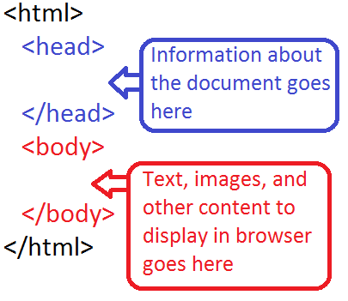
Basic HTML Syntax
The <head> element contains information used by the Web browser, and you place it at the start of an HTML document, after the opening <html> tag

Slide 25
Basic HTML Syntax
The <head> element and the tags it contains are referred to as the document head
Following the document head is the <body> element, which contains the document body

Slide 26
Basic HTML Syntax
The <body> element and the text and tags it contains are referred to as the document body
Most browsers will make an effort to figure out the HTML if head and body elements are not defined
The <body> element is the container of the document’s HTML content.
A Web browser’s process of assembling and formatting an HTML document is called parsing or rendering

Slide 27
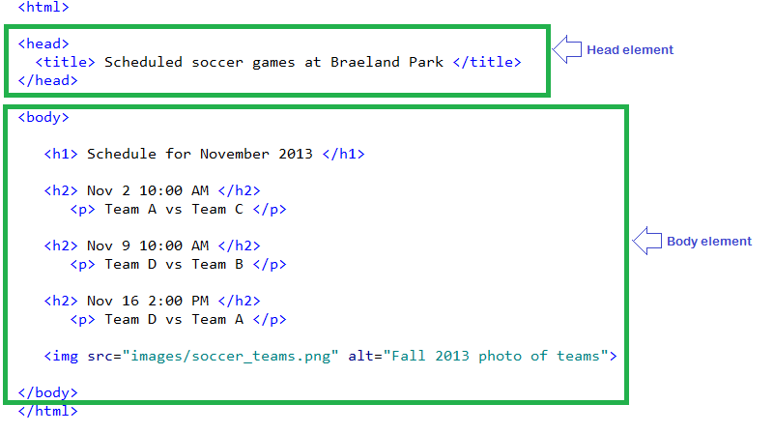
HTML content syntax example

Slide 28
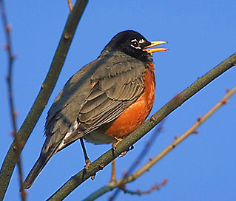
Basic HTML Syntax
Additional element parameters, called attributes, configure many HTML tags
Attributes appear before the closing bracket of the starting tag, and separated from the tag name or other attributes with one or more spaces
Sequence order of the attributes does
not matter inside the element
Attributes within an element should not be duplicated
Typically all attribute values are
enclosed by single or double quotes
<img src=“robin.png”
alt=“photo of a robin”>
This element has two attributes: src and alt

Slide 29

Deprecated HTML tags
Many formerly commonly used HTML tags have fallen out of usage – presentation tags
These deprecated tags have been replaced with CSS. Most browsers will still accept them though
Examples of HTML tags no longer recommended:
<applet>
<background>
<font>
<center>
<strike>
<u>
Usually any HTML tag
that affects the display
of the content text has
been deprecated.

Slide 30
Creating HTML
Since HTML is text, any text editor can be used to create and edit HTML documents
In this course we will use TextPad for the first lab
Later labs we will use Adobe Dreamweaver, which previews your HTML (WYSIWYG), formats and organizes your web site content
KompoZer (www.kompozer.net) is an open-source alternative to Dreamweaver.

Slide 31
HTML Readability
The HTML you prepare in the labs must be easily human-readable, with appropriate white space and blank lines.
When in doubt, ask yourself, what if I had to figure out what this is doing, for the first time?
Do not use the Windows built-in Notepad – it does not support colour context highlighting of the HTML tags, attributes and content.
Do not use any space before or after the equals
  e.g. <img src=“robin.gif” alt=“picture of a robin”>

Slide 32
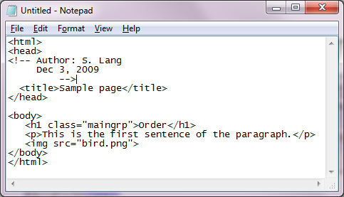
Notepad HTML
The tags and content are
the same colour making
it harder to read.

Slide 33
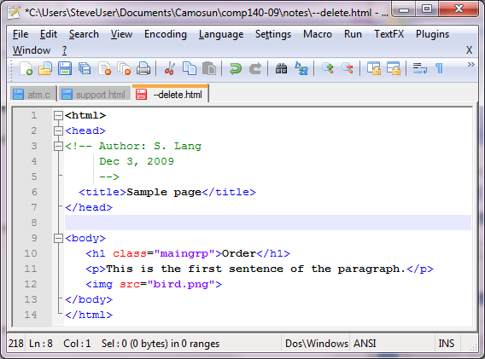
Notepad++ HTML
Notepad++ helps
HTML readability
by making the HTML tags
and content different
colours.

Slide 34
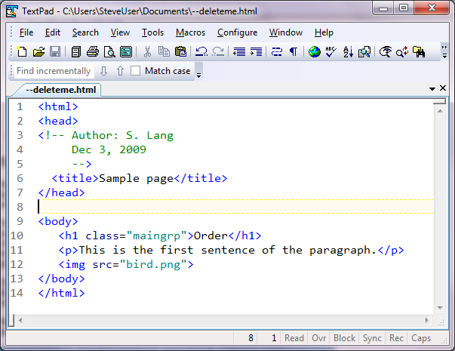
TextPad HTML
Similarly with TextPad. With
colour context highlighting,
it becomes easier to read
and edit HTML content.

Slide 35
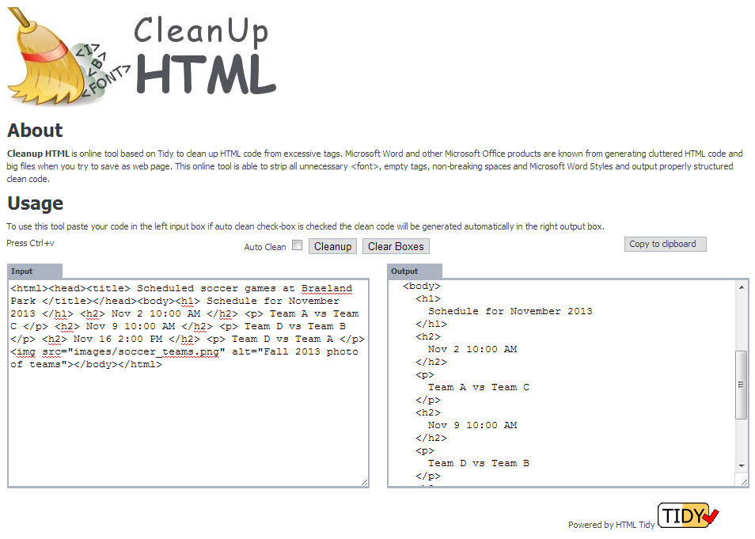
http://www.cleanuphtml.com/cleanup.html
Would you prefer to read and edit
this version of the HTML content
or the other side’s version?

Slide 36
HTML Render
The user agent (browser) accepts the HTML content (the ‘parsing’ process) and determines how it should appear based on the HTML information
This process is called “rendering”
Browsers are extremely forgiving in regards to HTML problems – missing tags, incorrect order of structure
Browsers will do the best they can but the display results may not be what was intended

Slide 37
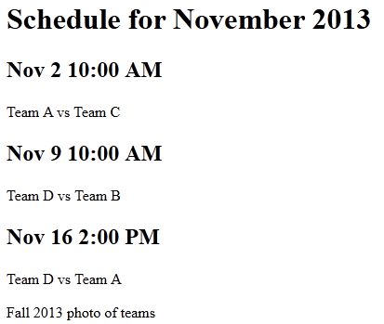
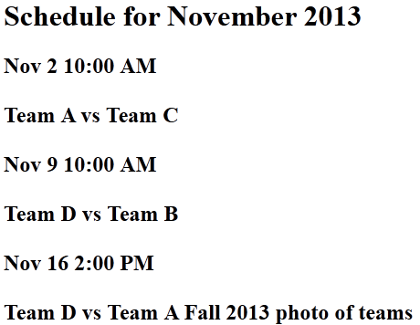
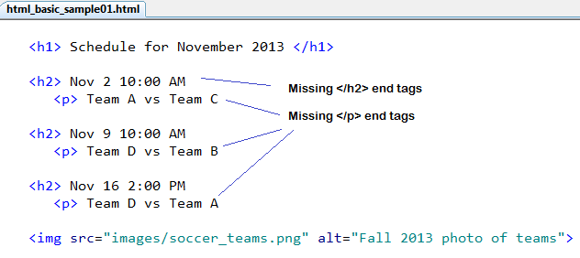
HTML missing tags
Instead of the browser
displaying the HTML content
like on the left, the missing
end tags make the display
look like on the right.

Slide 38
HTML shows structure not style
HTML presentation tags are deprecated in favour of CSS so that style definitions are kept separate to simplify web page design and maintenance
Use HTML tags to indicate the structure of the document content rather than its style
Structure type tags can specify a heading, paragraph, article, form, table, list, division, span, etc.

Slide 39
HTML and Content
HTML defines how content is structured
Web pages with same HTML tags all share identical style (e.g. all headings appear the same)
Style sheets enable web designers to customize the appearance of the displayed content
If the style changes for one tag, then the style definition for that tag only has to be updated – not all occurrences of that tag.
We will use CSS (Cascading Style Sheets) to define styles in later labs

Slide 40
HTML element
The html element represents the root of an HTML document
The attribute lang provides the document’s language, which aids speech synthesis tools to determine what pronunciations to use
<html lang=“en”>
...
</html>
Document’s language is English
HTML content goes in here

Slide 41
HTML character encoding
International characters are supported starting with HTML version 4 (web becomes multilingual)
HTML content should indicate a character encoding
Makes it easier for some browsers with different default encodings (languages) to view the pages
In the head element the first element should be:
<meta http-equiv=“content-type”
content=“text/html; charset=utf-8”>
http://www.sitepoint.com/do-you-know-your-character-encodings/

Slide 42
Meta tag
Within the head element of the HTML content additional information about the HTML is specified using the <meta> tag
<meta> does not render anything in the browser.
<meta name=“author” content=“John W. Smith”>
<meta name=“description”
content=“Free pictures of cats and dogs”>
<meta name=“keywords”
content=“cat, dog, feline, canine,
animal, mammal, free pictures”>
<meta http-equiv=“refresh” content=“5”> automatically refresh the current web page every five seconds

Slide 43
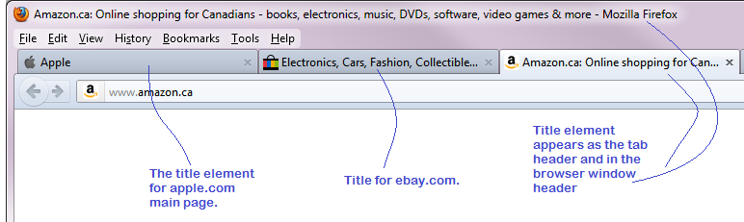
Title HTML
Each HTML page should have a <title> element defined within the head element
This is the text appearing as the window title in the browser
Only text – not HTML– can be defined within the <title> element
The title is used in many search engines
The title is used in browser History lists, Favorites and Bookmarks
<title> Order Information </title>

Slide 44
Dynamic HTML
Static HTML refers to a fixed HTML page which is not updated before it is displayed by the browser
Dynamic HTML uses a script language (like JavaScript, PHP, or ASPX) to show updated information every time that page is shown in the browser
E.g. Show the current time on the browser page
Provide feedback when completing an online form
Show information from the web server

Slide 45
Web Page Design and Authoring
Web page design, or Web design, refers to the visual design and creation of the documents that appear on the World Wide Web

Slide 46
Web Page Design and Authoring
Web page authoring refers to the creation and assembly of the tags, attributes, and data that make up a Web page

Slide 47
Web Page Design and Authoring
This is a subtle, but important distinction:
  A book on Web design teaches the visual and graphical design aspects of creating Web pages
  A book on HTML teaches the more basic concepts that you need to get started, such as how to work with tags and attributes

Slide 48
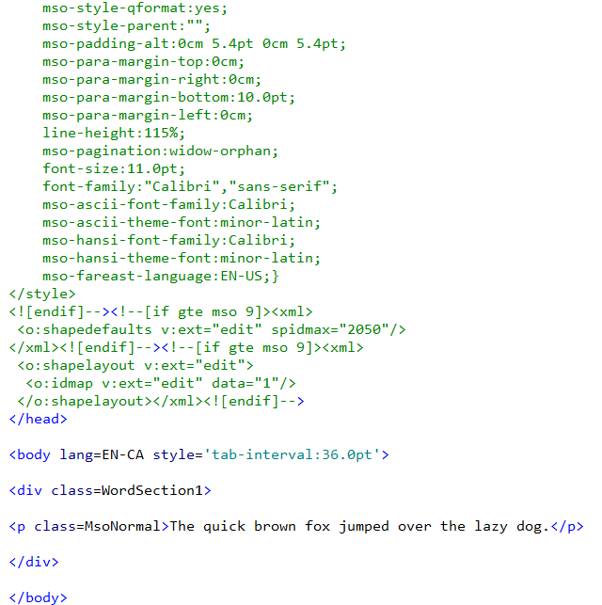
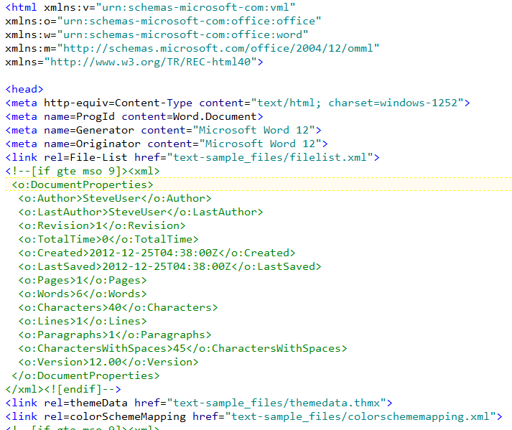
Export as HTML
Many applications such as Microsoft Word will allow the user to export into HTML format
DO NOT DO THIS unless told to do so!
The exported HTML is unmaintainable
438 lines of HTML
and CSS for one
line of content:
The quick brown
fox jumped over the
lazy dog.

Slide 49
HTML comments
HTML comments provide descriptive information to the human reader only – not to the browser
You may not nest comments (define a comment inside an existing comment)
Comments can appear anywhere but they usually appear in the <head> section.
<!-- Author: John P. Smith.
Created: Sept 28, 2012
-->

Slide 50
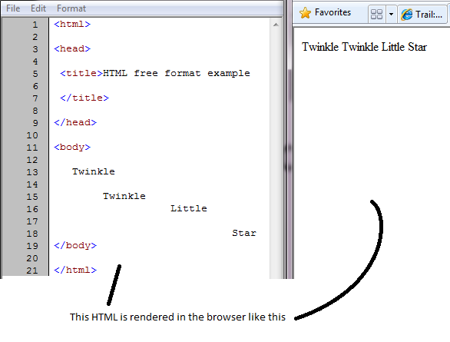
Free format
HTML is free format – any ‘white space’ you enter in the HTML text is ignored by the browser

Slide 51
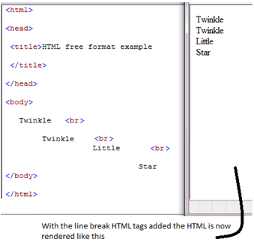
Line Break
The rendered HTML needs to provide the necessary formatting you want to see rendered properly in the browser:
<br> is the
HTML line break
element to force
a new line

Slide 52
Block elements
Some HTML elements automatically force a new line by default. These are the block elements.
<p> A new paragraph … </p>
<h1> A new heading </h1>, <h2>, etc, <h6>
<table> … </table>
<form> … </form> - online form
<div> … </div> - generic block-level container
<ol> ordered list of items </ol>
<ul> unordered list of items </ul>
<hr> horizontal line

Slide 53
Block elements
Only block elements can have a width property (exceptions: input element image and object element)
More block level tags … this list is not complete
<dl> definition list </dl>
<pre> preformatted text </pre>
<blockquote> block quotation </blockquote>

Slide 54
Inline elements
Inline elements do not force a new line
<a> anchor </a>
<b> bold </b>
<img>
<span> generic inline container </span>
<del> text to be shown as deleted </del>
<map> </map>
<object> plug-in resource </object>
<q> Short quotation </q>
<input>, <label>, <select>, <textarea>

Slide 55
Anchor
Anchor tag defines a hypertext link to another resource on the internet, or another part of the same HTML document
Anchors can be defined for text or images
Typically the hypertext link is indicated in the browser by three cues:
  The image is bordered in blue by default
  The text is underlined and coloured blue by default
  When the cursor hovers over link, the status bar shows the reference and the cursor changes shape

Slide 56
Anchor
Anchor attribute href is for hypertext reference
<a href=“internet resource”>some text </a>
Reference can be absolute URL or relative URL
Visit <a href=“http://www.apple.com”> Apple </a>
My dog <a href=“images/myDog.jpg”>Spot</a>

Slide 57
URI
Uniform Resource Identifier (URI) is used to uniquely identify the location and method of access to a resource (file, image , video, etc)
URI can be absolute or relative e.g.:
http://www.example.org/absolute.html
relative/index.html
Use relative URIs in your HTML in case
your web site changes its name or
location.

Slide 58

Anchor destination
If the supplied URL is not accessible, the web site will return an HTTP 404 error code
Caused by a “dead link” also called “broken link”
Be aware of “link rot” – the process by which website links become irrelevant or broken as time progresses – servers move, folders copied, content changes, redirect to new locations, information becomes out of date
  a serious problem for search engines

Slide 59
Anchor names – HTML v4 only
For large HTML documents you can place named anchors at the start of each section of content
<a href=“#aardvark”>About aardvarks</a>
<a href=“#giraffe”>Great giraffes</a>
<a href=“#tiger”>Terrific tigers</a>
...
<h2> <a name=“aardvark”>About aardvarks</a> </h2> ....
Name part of the anchor is at the end of the URL as in <a href = “http://www.calgaryzoo.com/zoo.html#bear”> Bear</a>
For HTML v5 use the ID attribute instead of name

Slide 60
Anchor names – HTML v4 only
Anchor names must be unique within the HTML document – case does not matter
  If duplicate names are found, the first is used
  If name is not found, top of the document shown
Anchor names must be valid alphanumeric characters (a-zA-Z0-9) – no spaces
An anchor link may not be nested inside the tag of another anchor link
If you forget the closing </a> tag, the entire text will be make a hypertext link

Slide 61


Anchor title
The title attribute specifies a tooltip text to add information about a link for the user
Can be used by those who are visually impaired to cause the browser to “speak” the link
<a href=“aardvark.html” title=“This link will take you to the aardvark page”> The Aardvark </a>

Slide 62
Anchor target window
By default the clicked reference will open in the same browser tab
The target attribute can direct the browser to open a new tab (or window) instead with target=“_blank”
But it can make your HTML page non-compliant for strict XHTML
<a href=“http://www.cbc.ca” target=“_blank”> Open news in new tab</a>

Slide 63
Link Text Guidelines
Write text as if there are no links -- make the text of the link meaningful
e.g. <a href=“index.html”>Home</a>
vs <a href=“index.html”>Start page</a>
The <a href=“internet-info.html”>Internet</a> uses hyperlinks.
Avoid “click here” and similar meaningless text as link text
Link text

Slide 64
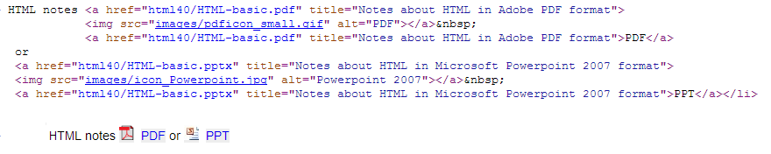
Link Text Guidelines
Limit the length of the link text. Avoid making entire sentences or paragraphs as link text.
Provide information about the link if it is a very large file or will open a new browser window or requires a plug-in
  Some use visual cues such as icons
Provide the title attribute
PDF and Powerpoint icons used.

Slide 65
Accesskey
The optional accesskey attribute specifies a keyboard shortcut to access an anchor element
<a href=“index.html” accesskey=“h”>
Home
</a> <!-- press alt-h to access this element-->

Slide 66
Tabindex
The optional tabindex attribute specifies the numeric order of the tab flow within an HTML document
When the user presses the tab key, focus is given to the next element higher in the tabindex order
<a ... tabindex=“1”>first</a>
<a ... tabindex=“2”>second</a>
<a ... tabindex=“3”>third</a>

Slide 67


Images as Anchors
Images may be anchor links
<a href=“big-photo.png”>
<img src=“bird-photo.png”> </a>
Or, including some text:
<a href=“big-photo.png”> Photo of a robin
<img src=“bird-photo.png”>
</a>
Usually the link images are thumbnails – links to a larger, higher resolution version of the image

Slide 68
File names
HTML files have a file extension of .html (or rarely .htm)
The HTML file name should not contain non-alphanumerics such as spaces ~ / | \ * ? & < > “ .
Good HTML file names Invalid HTML file names
favSongs.html fav Songs.html
report_2008.html report~2008.html
memberList_08.html notes
memberList$08.html March*list.html

Slide 69
File name case
Unix file names are case sensitive
The CST deepblue server runs the Unix operating system so … when you save your HTML files on your personal network drive, note the case of the file names you use (and folder names too)
A file name on that drive is Lab_01.html the URL must reference Lab_01.html not lab_01.html
e.g.
http://www.cs.camosun.bc.ca/~c9999/comp140/Lab_01.html

Slide 70
HTML Entities
Many characters (for example: < > & “) have a special use in HTML, and therefore cannot be used in the HTML document as regular text
To display them in the browser, you use an HTML entity, which is an encoded version, either entity name or entity number
Result | Description | Entity Name | Entity No. (Decimal)
 | Non-breaking space | &nbsp; | &#160;
< | Less than | &lt; | &#60;
> | Greater than | &gt; | &#62;
& | Ampersand | &amp; | &#38;
“ | Double quote | &quot; | &#34;
€ | Euro | &euro; | &#8364;

Slide 71
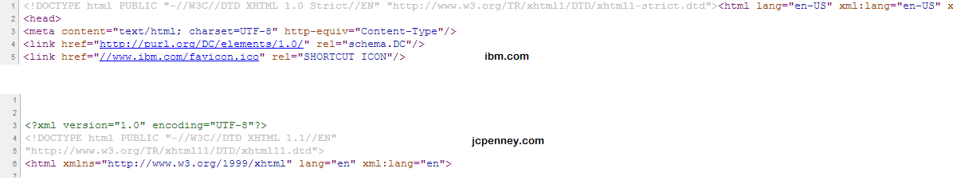
HTML DTD
Perform a ‘view source’ on any major commercial web page in a browser ...

Slide 72
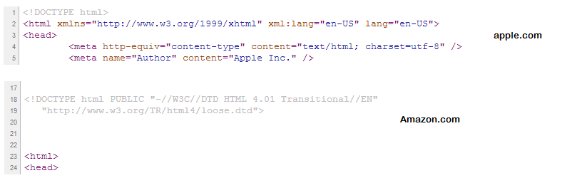
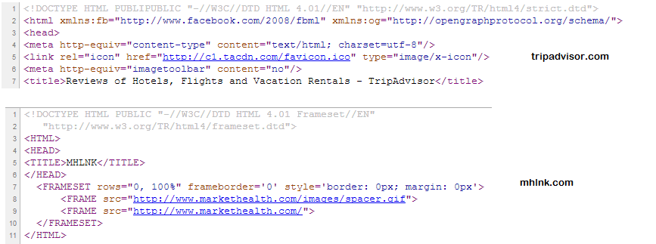
HTML DTD

Slide 73
HTML DTD
An HTML document requires a special header defining the “Document Type Definition” (the DTD is also used in some XML files)
HTML DTD defines the type of HTML rules the document is following (for backward compatibility)
  Strict – no deprecated HTML elements allowed
  Transitional – presentation elements like <font> allowed
  Frameset – for frameset documents (90’s feature)
These are for HTML version 4 only

Slide 74
HTML v4 DOCTYPE
In order to validate an HTML document, the DOCTYPE declaration may be used*
<!DOCTYPE html PUBLIC "-//W3C//DTD HTML 4.01 //EN" "http://www.w3.org/TR/html4/strict.dtd">
This header indicates that the following HTML follows the strict form of HTML version 4
There is some debate about how DOCTYPE is used by the browser – see http://www.hixie.ch/advocacy/xhtml

Slide 75
HTML v4 DOCTYPE
This header indicates that the following HTML follows the HTML version 4 transitional form, which is a looser form of the strict version (can accept some deprecated elements )
  <!DOCTYPE html PUBLIC
  "-//W3C//DTD HTML 4.01 Transitional//EN" "http://www.w3.org/TR/html4/loose.dtd">

Slide 76
HTML DOCTYPE
DOCTYPE is a declaration not an HTML element
Here are the parts of DOCTYPE
!DOCTYPE - the identifier, tells the browser that the information defines what type of document this is
HTML – the Top Element, tells the browser what is the top level element (<html>)
Public – the availability of the document
“-//W3C//DTD HTML 4.01 Transitional//EN” – Formal Public Identifier made up of : W3C – Organization name; DTD – the type of DOCTYPE; HTML 4.01 Transitional – the human readable label; EN – the DTD language

Slide 77
HTML DOCTYPE
Which DOCTYPE to use in your HTML ?
Depends. Unless the web page specifically needs to be XML compliant, use either the HTML 5 (recommended) or the 4.01 Transitional format (or do not supply one) for greater compatibility to other browsers

Slide 78
HTML 5
HTML version 5 – http://www.w3.org/TR/html5/
  Backwards compatible with version 4 but with new features to accommodate new “user agents” (i.e. cellphones, PDAs, etc)
  Use of the DOM (Document Object Model) to be part of the language
  New elements <section> <article> <aside> <header> <footer> <nav> <dialog> <audio> <video> <canvas> <time> <meter> and more
  New attributes for handling multimedia
  Current versions of browsers support only most characteristics of HTML5
  There is only one !DOCTYPE <!DOCTYPE HTML>

Slide 79
Browser Quirks
In order to accommodate older web pages, many browsers can switch their “engine mode”
Problem : each browser model can be at different stage of HTML compliance
Standards Mode – browser treats the document according to the HTML specification
“Quirks Mode” – browser is allowed to “break” the current HTML specification in order to avoid messing up the display of HTML pages authored according to practices that were prevalent in the late ‘90’s
Almost Standards Mode – Firefox, Safari, Opera may render the vertical sizing of table cells traditionally and not to the spec.
If you use the XHTML DOCTYPE, the XML declaration makes IE 6 (but not IE 7) trigger Quirks mode
http://www.quirksmode.org/css/quirksmode.html for examples

Slide 80
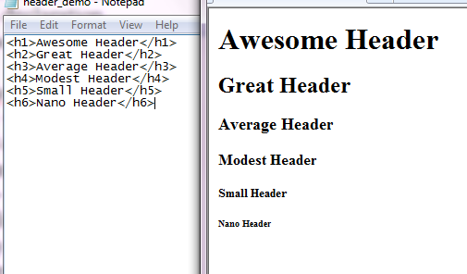
Structuring HTML Text
HTML structures the text content into various ‘containers’ such as a header, paragraph, article, table, ‘span’, and ‘division’ elements
Headers are defined based on the intended emphasis <h1> ... </h1> is the highest ; <h6> ... </h6> is lowest
Use <h1> for major
chapter headings

Slide 81

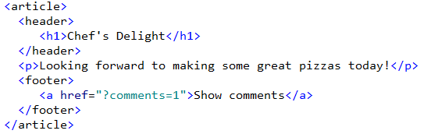
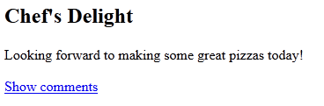
Article
An article element is a self-contained text such as a forum post, a magazine or newspaper article, a blog entry, a user-submitted comment, an interactive widget, or any other independent item of content

Slide 82
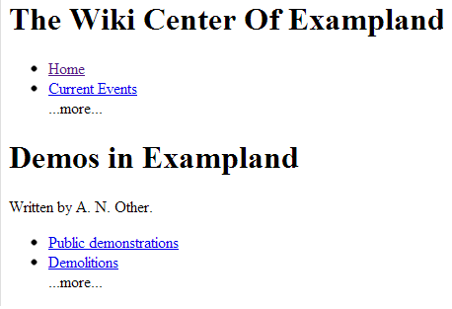
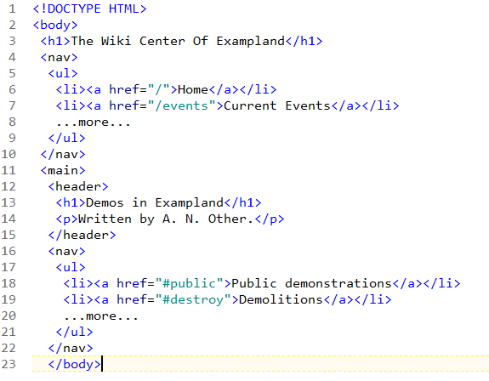
Nav
The nav element represents a section of a page that links to other pages or to parts within the page.

Slide 83
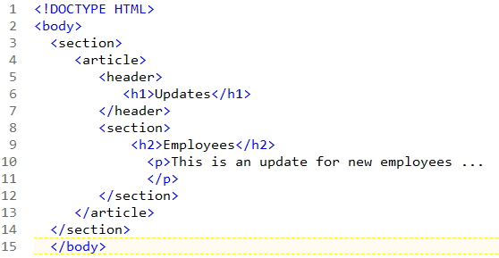
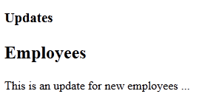
Section
The section element represents a generic portion or a document (e.g. chapter).
Content that would make sense to appear grouped
together (e.g. news or sports) should be within a
section element rather than a div element.
Use div element for content that just needs to
be styled as a block.

Slide 84
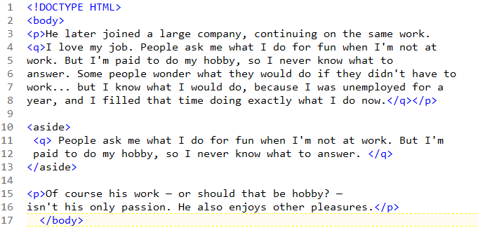
Aside
The aside element represents content that is tangentially related to main topic. Useful for sidebars or pull quotes.

Slide 85
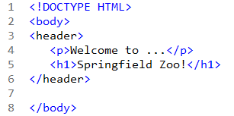
Header
The header element represents introductory content for its section content.
Usually contains the section’s h1-h6 element
Can also be used to wrap a section’s table of contents, a search form, or logos.

Slide 86
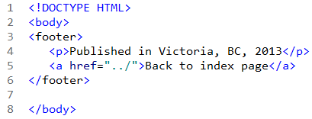
Footer
The footer element represents footer content for its section content.
Can show who wrote the content, links to related content, copyright data.

Slide 87
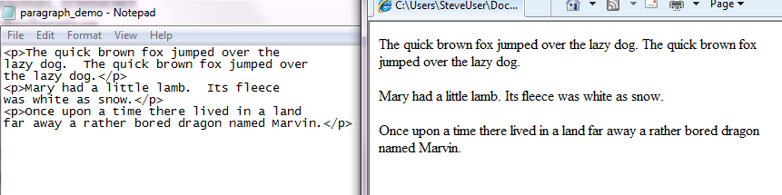
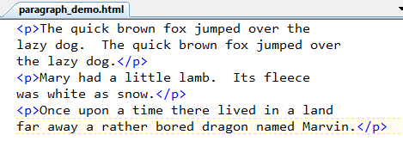
Paragraph
The <p> element defines a paragraph
If a paragraph’s end tag </p> is missing, the browser may assume the next <p> tag starts a new paragraph
Paragraphs may not contain block elements

Slide 88
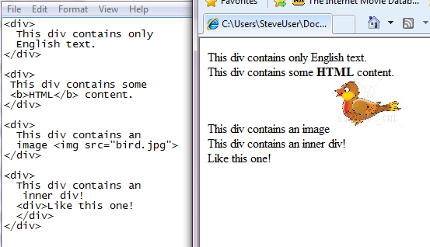
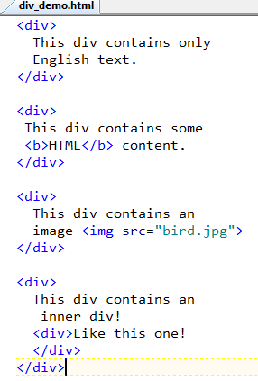
Division
Divisions are similar to paragraphs but are used to visually ‘block up’ related text or image content on the page – “generic block”
Usually divisions are defined having some CSS

Slide 89
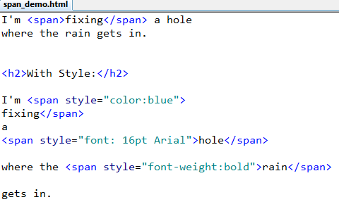
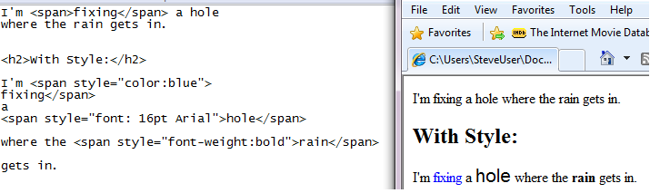
Span
Similar to div but span elements are inline
Defines a generic region of text
By itself span provides no text attributes

Slide 90
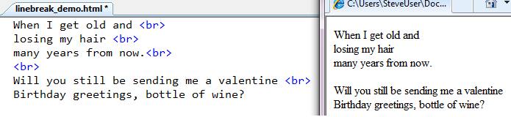
Line Break
The <br> element forces a line break
Do not use <br> to add space between paragraphs...use the CSS margin property instead

Slide 91
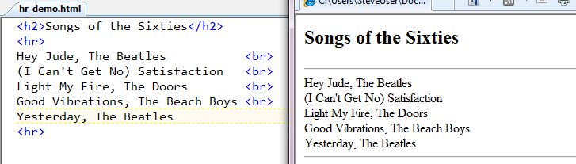
Horizontal Line
HTML <hr> element has been deprecated in favour of CSS but it is still used in web pages

Slide 92
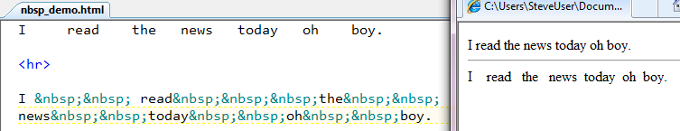
Forcing a space
The HTML entity &nbsp; is a non-breaking space
It forces a space to appear where one would not normally be shown

Slide 93
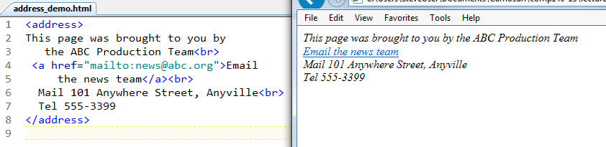
Address
The <address> element is intended to show the web page author contact information
Usually appears in header or footer of the web page

Slide 94
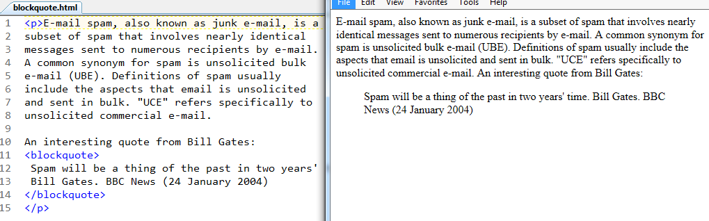
Blockquote
The <blockquote> shows a formatted quote

Slide 95
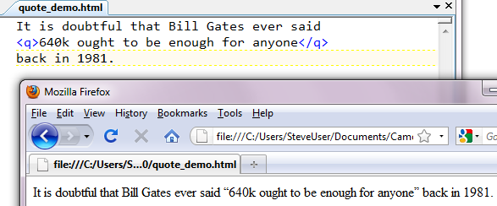
Inline Quote
The <quote> element is an inline version of blockquote.
Does not quote text in IE browsers

Slide 96
Text Format
The use of HTML to format the appearance of text is no longer recommended – use CSS instead
Physical style (deprecated)
  <b> Bold </b>
<i> Italics </i> <u> Underline </u>
<tt> Typeset </tt> <pre> abc </pre>
Logical style (preferred, if required)
  <em> Emphasis </em>
  <strong> Strong </strong> <del> deleted text </del>
  <code> keyword </code> <ins> inserted text </ins>

Slide 97
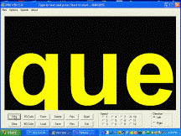
Non-Standard Text Format
Netscape-browser only text formatting tags (deprecated) – can cause problems for people with cognitive disabilities or epilepsy
  <blink> See this? </blink>
  <marquee> Scrolling text </marquee>
The <font>, <sub>, <sup>, <big>, <small>, and <strike> tags are also deprecated – use CSS !
Centering text in HTML used to be done with the now deprecated <center> tag – use CSS !

Slide 98
HTML Table Element
<table> </table> define a table element
Is a block element
Consists of rows and columns of cells each having the same dimensions of width and height
By default each column’s width is the minimum width needed to display the widest element within a column
Row heights accommodate the text or image contained in the cell
A table will not normally fill out the entire width of the screen or its container

Slide 99
HTML Tables
Table rows
Table data fits inside these squares.

Slide 100
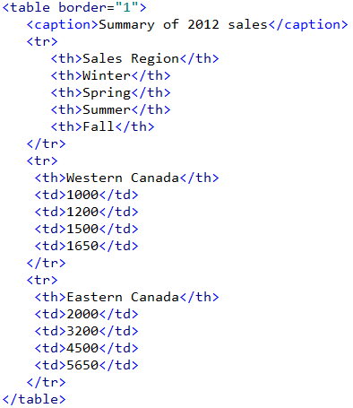

HTML Table Example 1
Table border
The column widths are not the same.
The text in the cells is aligned left by default.
The table does not span the entire screen
within the browser window.
The <th> elements are shown in bold by default.

Slide 101



First column width = 200 pixels
four column widths = 120 pixels each
Each td element is aligned right
HTML5 attributes do not
support text alignment
or width to format
col elements – use
CSS style instead.

Slide 102
HTML Tables
A table can be defined within a cell of a table
For example, a page can be defined as a large table and the cells used to contain tables for articles or pictures

Slide 103
HTML Tables
Basic table structure:
Within the <table> </table> tags are the table row <tr> </tr> tags – one for each row in the table
Within the <tr> </tr> tags are the table data <td> </td> tags – one for each cell in the row
Usually each row has the same number of <td> </td> tags defined

Slide 104
HTML Tables
What goes between the <td> </td> tags?
Anything: Text. Pictures. HTML. Lists. Headers. Table.
<table>
<tr>
<td>This is row one, first cell. </td>
<td>This is row one, second cell.</td>
</tr>
<tr>
<td>This is row two, first cell. </td>
<td>This is row two, second cell.</td>
</tr>
</table>

Slide 105
HTML Tables
If your HTML is missing a closing </td> or </tr> or </table> tag, the browser may correctly figure out what was intended to be rendered ... but no guarantees – always define the closing tags to be safe

Slide 106
Inner Table
<table>
<tr>
<td>
<table>
<tr>
<td> Inner table </td>
</tr>
</table>
</td>
</tr>
</table>

Slide 107
Table Attributes
Optional attributes for the <table> tag
border=“n” n is number of pixels – by default a table is shown without borders unless the attribute border=“1” is specified
width=“n” or = “p%” n is number of pixels – the maximum width of the table, or if a %, then the percentage width of the container
summary= “text” description of table’s purpose – not shown in the browser

Slide 108
Table Attributes
cellspacing = “n” or “p%” – defines the amount of space separating each cell
cellpadding = “n” or “p%” – defines the amount of space between the cell contents and the cell’s border
Deprecated in HTML5

Slide 109
Table Attributes
Some commonly used attributes are now deprecated in favour of CSS
align – specifies the position of table within the document

Slide 110
Table elements
caption tag is optional
<caption> Summary of Sales</caption>
table row <tr>
table data <td>
table header <th> -- by default renders the text in bold – used in place of <td> for the first row or first column

Slide 111
Table structure
For long tables containing many rows you can define sections <thead> <tfoot> and <tbody> to support the scrolling of tables – must define in that order
<table>
<thead>
<tr> ...header </tr>
</thead>
<tfoot>
<tr> ...footer </tr>
</tfoot>
<tbody>
<tr> ... first row </tr>
<tr> ...second row </tr> ...
</tbody>
</table>

Slide 112
Column groups
You may want to format a number of different columns in the same way (e.g. identical text font, colour, background)
Use the <colgroup> element
<colgroup span=“n” format> </colgroup> groups the first n columns together in the same format
<table>
<colgroup span=“5” width=“10”> </colgroup>
-- make the first five columns 10 pixels wide

Slide 113
Col element
Within the <colgroup> element you may specify style information for a column set within that group using <col>
<colgroup></colgroup>
<colgroup>
<col span=“3”>
</colgroup>
-- first column by itself; next three columns in a group – two parts separated by a border

Slide 114
Table Data
The <td> tag has optional attributes rowspan and colspan to define a cell that stretches into another row or column
<td rowspan=“2”> </td> - cell spans its row and the row below it
<td colspan=“2”> </td> - cell spans its column and the column to the right

Slide 115

Colspan
<table border=“1”>
<tr>
<td> row 1 cell 1. </td>
<td> row 1 cell 2 </td>
</tr>
<tr>
<td colspan=“2”>row 2 cell 1
</td>
</tr>
</table>

Slide 116

Rowspan
<table border=“1”>
<tr>
<td rowspan=“2”> row 1 cell 1
</td>
<td> row 1 cell 2 </td>
</tr>
<tr>
<td> row 2 cell 2 </td>
</tr>
</table>

Slide 117
Lists
Ordered Lists
  Open application
  Click File menu
  Select Open option
Unordered Lists
  apple
  banana
  cherry
List items

Slide 118
Ordered Lists
Use the <ol> </ol> tags with list items identified by the tags <li> and </li>
<ol>
<li>Open application </li>
<li>Click File menu </li>
<li>Select Open option</li>
</ol>

Slide 119
Unordered Lists
Use the <ul> </ul> tags with list items identified by <li> and </li>
<ul>
<li>apple </li>
<li>banana </li>
<li>cherry </li>
</ul>

Slide 120
Lists
A list can appear as a list item within an outer list -- but the newer HTML, version 5, may not validate this.
<ul>
<li>
<ol>
<li> Open application </li>
</ol>
</li>
</ul>

Slide 121
Lists
A list item can be text, images, multimedia, hypertext references, tables, etc
The numbering type of ordered lists (Roman numerals, e.g.) and the bullet types for unordered lists (square bullets, e.g.) is defined with CSS

Slide 122

Definition Lists
Defines a term and its description
<dl>
<dt>CIO</dt>
<dd>Chief Information Officer, the person
responsible for directing information technology policies within an organization</dd>
<dt>hacker</dt>
<dd>Highly skilled computer programmer</dd>
</dl>
<dl> = start of a definition list
<dt> = start of a definition term
<dd> = start of a definition description

Slide 123
Images
The <img> element specifies that an image is to be shown
Attribute src defines the location and name of the image file
Attribute alt defines text to display if image cannot display (it is missing, for example)
Image types can be any valid picture format: jpg, png, bmp, gif, pcx, etc
The web server configuration file defines which picture files are acceptable based on the file name extension

Slide 124
Images
<img src=“http://www.mypics.com/bird.png”
alt=“robin”>
<img src=“images/spot.jpg”
alt=“blue spot”>
<img src=“bigBlue.bmp” alt=“IBM logo”>

Slide 125
Images
Images can be hypertext links
The image by default will be bordered in blue
Use the anchor tag surrounding the img tag
<a href=“myDog.html”
title=“Visit my dog”>
<img src=“spot.jpg”>
</a>

Slide 126
Image attributes
width=“n” or “p%” -- override the image width dimension (obsolete – use CSS)
height=“n” or “p%” – override the image height dimension (obsolete – use CSS)
alt is strongly recommended to describe the picture in case it cannot be displayed
  avoid irrelevant or meaningless alternate text
<img src=“myDog.png” alt=“My dog Spot is a Golden Retriever.”>

Slide 127

Image Thumbnails
Rather than display an entire selection of large pictures – a “thumbnail” version of each picture can be shown instead – and each thumbnail image is a link to the larger version
Saves bandwidth, more efficient
Do not use the height and width attributes in the HTML to scale down the original image to make the thumbnail – make a separate image instead

Slide 128

Image Slicing
Images can be ‘sliced’ using photo editing software into smaller pieces – downloaded separately and
integrated by
the browser
into a single
seamless
image.

Slide 129
Image attributes - deprecated
align – define position of image on the current text line (top, left, bottom, middle, right)
border – define border width around image
hspace – define amount of white space to the left and right of the image
vspace – define amount of white space above and below the image
Use CSS instead

Slide 130
Imagemaps
An image can be a hypertext link in HTML
A larger image can contain multiple hypertext links – aka “client-side” map
  The good: map of Canada; each area, when clicked, links to a specific HTML page, house floor plan, US map of states
  The bad: “mystery meat” navigation example
  The ugly: image of something abstract or random – no idea which part is a link or what is for (aka “mystery meat”)

Slide 131

Imagemap define hotspots
HTML elements <img> <map> and <area>
<img src=“map_picture.png” usemap=“#map”>
...
<map name=“map”>
<area shape=“rect” coords=“1,1,10,10” href=“first_link.html” >
<area shape=“circle” coords=“50,50,3” href=“ring.html”>
<area shape=“poly” coords=“20,30,15,25,22,27,20,30” href=“poly.html”>
<area shape=“default” href=“index.html”>
</map>
rect shape defines the
two x,y points as the top
left and bottom right
circle shape defines the
x,y center and the radius
poly shape defines the edges
of the polygon shape as x,y
sequences
default shape is for all other
areas on the map not linked
to a defined “hotspot”

Slide 132
Imagemaps
This once popular navigational tool has fallen out of favour for most web designers
Adobe Dreamweaver has a tool to help you define imagemaps
DHTML (“JavaScript”) is easier and more flexible

Slide 133
Object
Embedded objects such as Shockwave files, Java applet files, Microsoft ActiveX files, audio files, or other video type of file are defined using the <object> element
<object classid="clsid:F08DF954-8592-11D1-B16A-00C0F0283628" id="Slider1" width="100" height="50">
<param name="BorderStyle" value="1" />
<param name="MousePointer" value="0" />
<param name="Enabled" value="1" />
<param name="Min" value="0" />
<param name="Max" value="10" />
</object>
classid attribute
defines a class ID value
as set in the Windows
Registry or a URL
The <applet> element is obsolete – use <object> instead.

Slide 134
Object ClassID
<object classid=“yahtzee.py” codetype=“application/x-python”
standby="Ready to play Yahtzee?“ title="My Yahtzee Game">
<object classid=“java:Yahtzee.class” codetype=“application/java”
width=“400px” height=“250px” standby="Ready to play Yahtzee?"
title="My Yahtzee Game">
<object data="yahtzee.gif" type="image/gif" title="A Yahtzee animation" width=“200px” height=“100px”>
Yahtzee is my <em>favourite</em> game!
</object>
</object>
</object>
For browsers that cannot display the embedded object as Python, they can try running the Java applet version. An image is provided for browsers not able to show the Java or Python applets.
From htmlhelp.com

Slide 135
Web Browsers
You must test your Web pages in every browser and browser version in which you anticipate they will be opened.
Web tools:
  Browsershots.org
  http://spoon.net/browsers/
  http://www.thesitewizard.com/webdesign/multiplebrowsers.shtml

Slide 136


Accessibility
http://www.cew.wisc.edu/accessibility/evaluation/section508presentation.htm

Slide 137
Questions?

Slide 138
References
Writing Good Link Text: http://www.webrichtlijnen.nl/english/manual/development/production/link-navigation/writing-good-link-text/
Image Slicing Tutorial http://www.blogspottutorial.com/2008/12/photoshop-tutorial-basic-technique-of.html

